Slide 1
Empowering Data-Driven Decisions Analytics Enablement Framework for your Department
A Case Study of Facilities Operations & University Planning, Design, and Construction
Presenter: Zachary Rosensohn
Enterprise Applications - ITS
Notes:
Whether or not you touch data daily, this will give you a high-level view of what’s possible—no tech deep-dives, I promise. Today, we'll explore how a well implemented PowerBI Architecture is transforming data access and reporting for two key university departments, and how you can leverage similar approaches in your own area.
Examples of reduction of friction – writing reports….why is this even here?

Slide 2
What You'll Learn Today
🧩 The Problem Why reporting can be hard 💡 A Solution How two departments transformed their process 🚀 Increase Department Cross-functionality How Departments are sharing more data 🤔 Imagine It What could your department do with this?
Notes:
Today I will present a case study as an example of what's possible.
I hope to encourage the audience to think about how a similar approach could benefit their own departments.
Think about the potential use cases and the value of having a unified, easily accessible data environment.

Slide 3
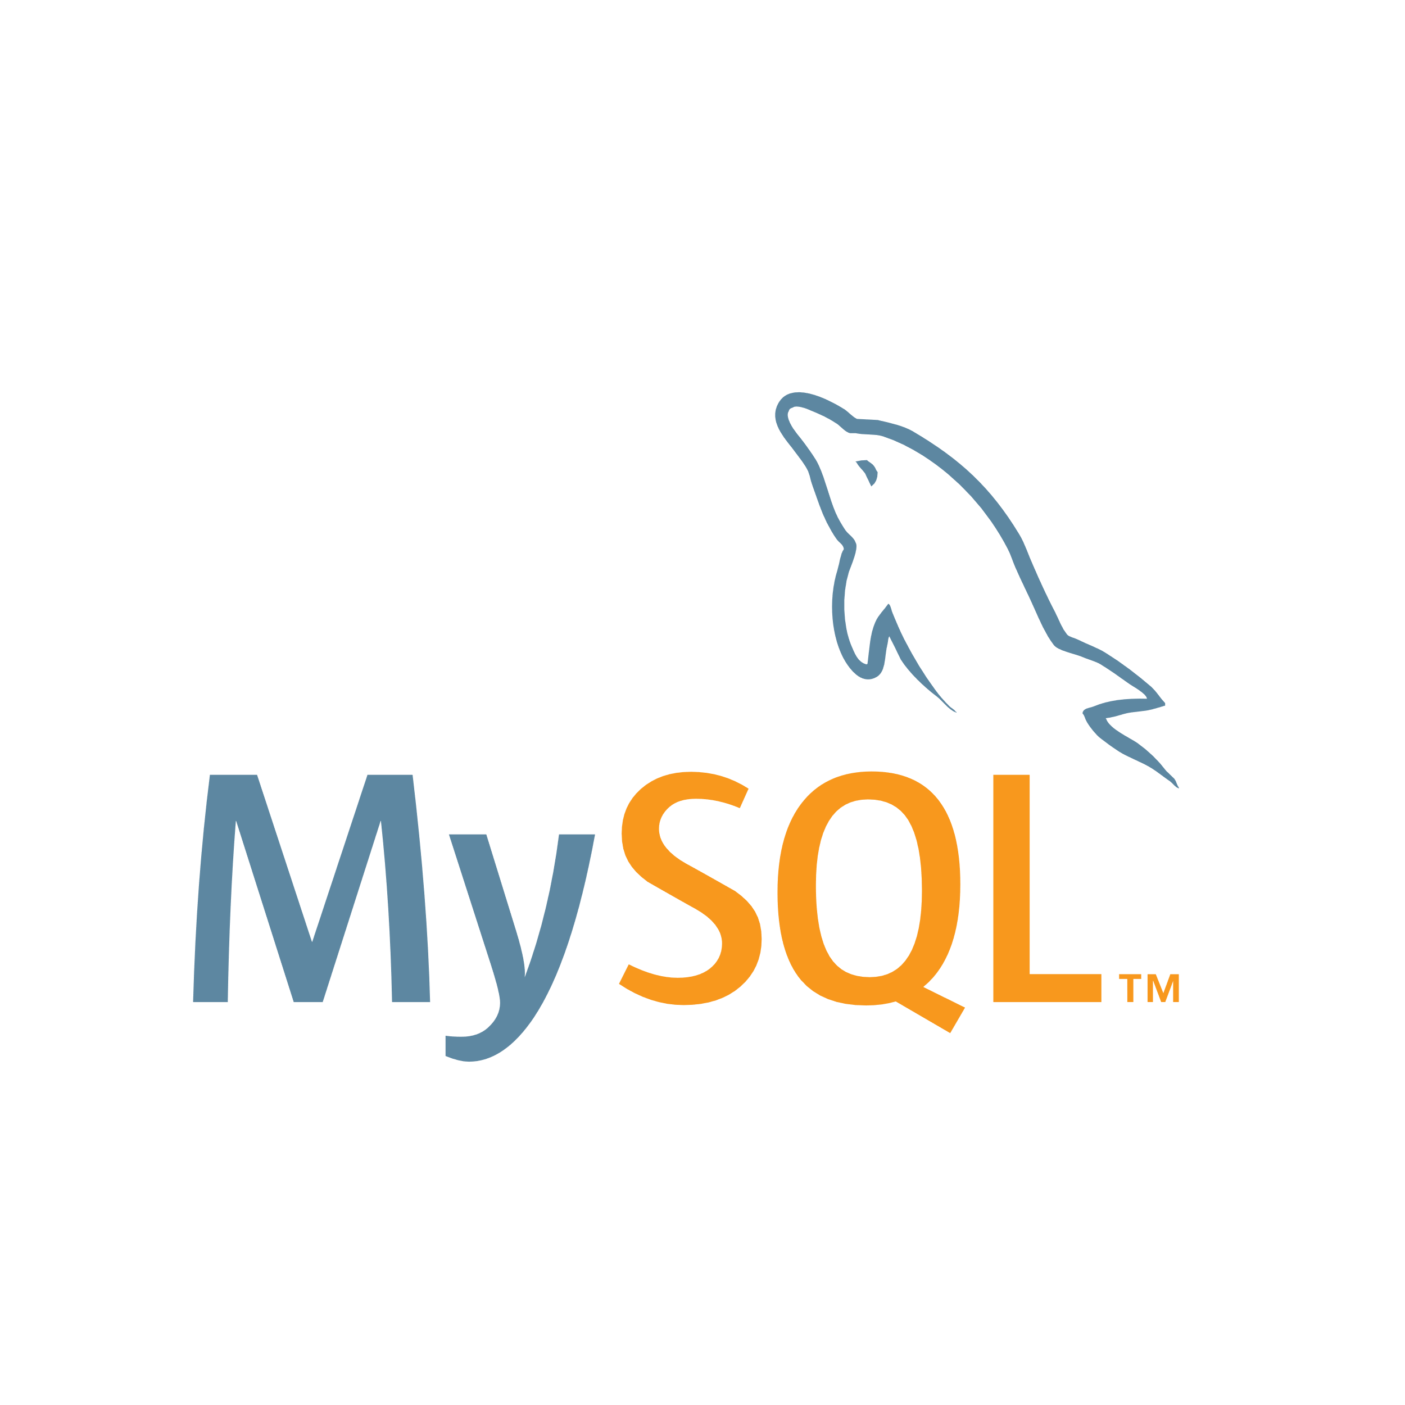
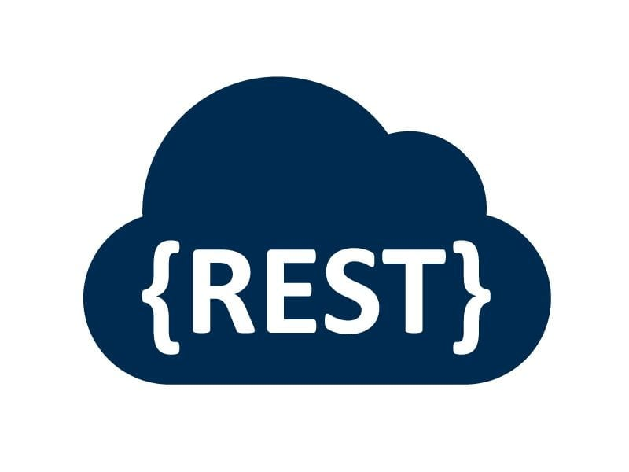
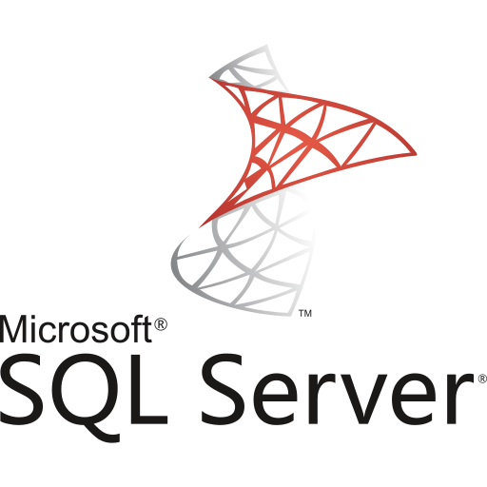
The Reporting Struggle
Disparate systems
Manual workarounds
Data access issues
Delays + inconsistencies
Notes:
Each department has data, but it's spread out and tough to access.
That often leads to custom work and ITS involvement. Vendors who change…oh the agony….the pain…
It’s a pain for ITS it’s a pain for the customers (you!)
So how did we get here….

Slide 4
Case Study
Facilities Operations & University Planning, Design, and Construction
Notes:
The STORY: AiM brought us here. We thought about our footprint of apps that lacked reporting
So if we were to develop a solution we wanted it to scale to the other applications in the department
Decision matrix
MS365 is used by University
if we are going to take the time to release we want it to work for all of our systems

Slide 5
So Many Data Sources!
Notes:
So the reporting tool needed to be agnostic of the data source
What are all of the data sources
a connectors
Mke sure to wtch out on vocb
Tke temperature of udience

Slide 6
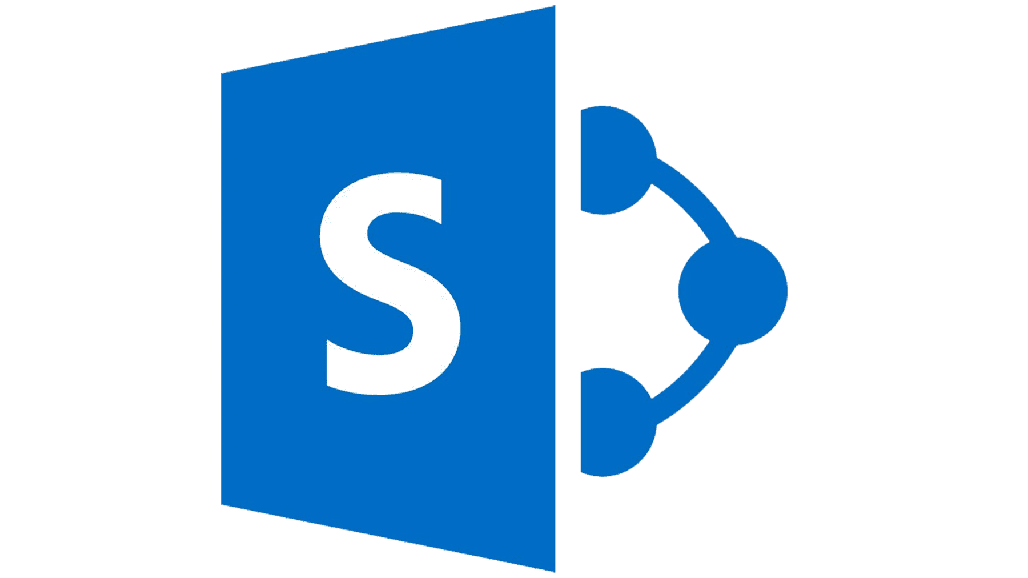
One Gateway.
Central access through on-premises data gateway
Azure Apps
& Services
Power Automate
Power Apps
Power BI & Report Builder
On-premise Data Gateway
Decrypts data source credentials securely and connects to data source
Sends queries to data sources and returns the results to gateway cloud services
+
On-premises data sources
Custom API
SQL
Flat Files
Share Point
Notes:
The big shift: ITS creates secure, reusable data connections that you build from. Think of it like clean water coming from a tap. Able to connect to all of those different solutions

Slide 7
Trusted Data.
Shared semantic models scoped to your department

Slide 8
Better Decisions.
Build reports yourself—no deep tech required

Slide 9
Case Study: Facility Ops
Before
After
Dependent on disparate reporting tools
01
01
Self-service / single platform for reporting
🧨
High-barrier of entry tools
02
02
Empowered staff
Manual spreadsheets
03
03
More efficient publishing
Notes:
Facilities is a perfect example. We moved from patchwork reporting to sustainable, self-service dashboards.
Centralization of all ITS support staff from Facilities Operations limited the technical knowledge of the department to heavily rely on imbedded reporting tools in all FO owned applications.
Where the "out-of-the-box" imbedded reporting tools do not meet the requirements of the department, or significant changes to them no longer meet reporting needs, ITS is tasked with implementing solutions to overcome these obstacles. This has created single-points of failure that take significant resources on the functional and ITS side to reverse-engineer and transform into sustainable solutions Varying reporting tools and platforms, leading to inconsistency in functional reporting:
Imbedded application reporting tools
Open-source reporting tools
University-wide managed tools
Spreadsheet manipulation
Functional areas rarely have adequate database structure insight to be able to reasonably extract data in a meaningful way
V-Lookup hell

Slide 10
How This Helps You
✅ Faster development
🔐 Trusted data
Reporting tools are intuitive giving those who work with excel a familiar experience.
Semantic models ensure accuracy.
🕒 Timely Insights
🔗 Embedded anywhere
Dashboards refresh automatically.
Teams, Aurora sites, Office 365, subscription emails, etc.
Notes:
This isn’t just about IT efficiency. It’s about making it easier for you to get what you need without waiting in a ticket queue.

Slide 11
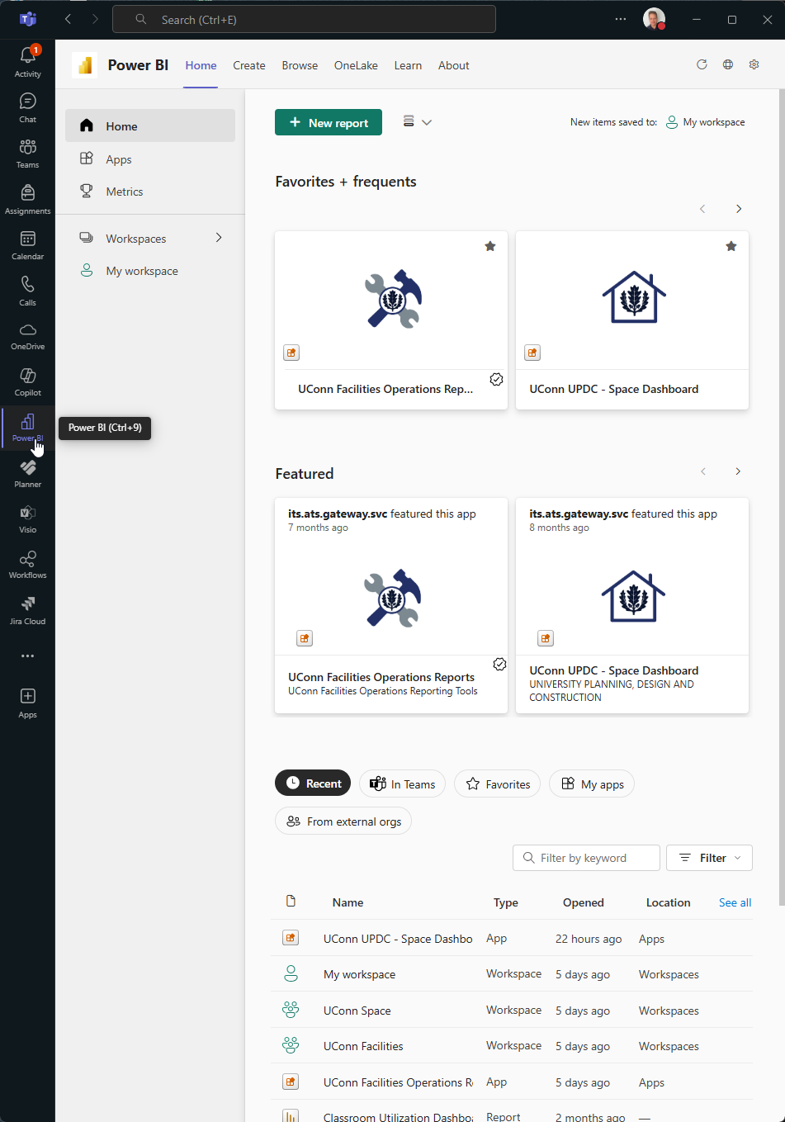
Teams Demo
Notes:
Show a demo of the two apps and how they are scoped to different audiences.
start by showing audiences
Show By Building
Explain that this is a PowerBI “Report”
Explain how to navigate briefly
Show some pretty colors and graphs
Move to floor plans, demonstrate external links and download
Mention how this audience is managed by a 365 Group owned by UPDC
Quickly show capital projects and UPDC Internal
Mention that these are internal to UPDC employees
Show how to exit an app and spin up Facilities Operations App
Start with Scheduled Reports
Explain that this is a PowerBI “Paginated Report”
Demo printing to PDF
Demo Subscriptions
Mention that owners/admins of PowerBI Service (Cloud) can manage subscriptions in conjunction with the creator of the subscription
Show Asbestos Dasboard with little explanation as people get why this is needed
Demo Res-Life dashboard
Show drill through technique to pique interest
Demo Projects
Show parameter feature
Mention this is work in progress
Show our internal tracking for the final WOW
But I’m getting ahead of myself, but I did learn from Quinten Tarantino that sometimes it is an effective hook to show you the end at the beginning of the flick. So…how did we get here (ha. Ha. Ha.)

Slide 12
What We’ve Learned
🚀
Empower, Don’t Gatekeep
Give users tools to build—don’t make them wait on IT.
🧪
Start Small
One model, one report. Pilot with a team.
🤝
Collaborate Early
Work closely with departments to understand real needs.
Notes:
We didn’t get here overnight. We started small and scaled up with feedback. The best ideas came from the departments themselves.
Each semantic model will take at least one live/in-person requirement gathering session.
Create Microsoft 365 Groups to use as access groups
Use available distribution lists for as access groups
Scope access to Workspace App Audiences

Slide 13
With trusted data at your fingertips, you are only limited by your imagination.
🎓 Build enrollment dashboards
📈 Spot trends in spending or hiring
📊 Create ad-hoc reports for compliance
🌟 Visualize program impact
Notes:
Imagine: What decisions could you make faster? What data stories could you tell?

