Slide 1
Where should I store my files?
Dan Jakubiak

Slide 2
App icons

Slide 3
Why two apps? Which one do I use?
Apps seem very similar and functions overlap
Apps are interconnected
It's possible to do your job with either one of them
Easy to get lost and forget data location
As a group, need to decide

Slide 4
Important Note
HIPAA and FERPA Compliant*
Lose access when you leave UConn
Supervisor has access to your files for a short time when you leave UConn

Slide 5
Quick Introduction to the services

Slide 6
OneDrive
Cloud-based file storage
What is the cloud?
A computer you don't have physical access to
OneDrive is storage for individuals
When you leave, the data leaves

Slide 7
SharePoint
Cloud-based file storage
Storage for departments
Files are owned by the SharePoint site, not individuals
The data stays

Slide 8
A case for OneDrive
Desktop items
Downloads folder
Drafts of Knowledge Base Guides - kb.uconn.edu
Screenshots
Presentations like this one

Slide 9
A case for SharePoint
Central location for Department files
Spreadsheets / Documents
Guides / Procedures
Literally anything that should persist

Slide 10
SharePoint
How does SharePoint operate?

Slide 11
SharePoint - Membership
SharePoints are known as "SharePoint sites"
Sites have Owners, Members, and Visitors
As well as any custom group you desire
Ensure you have at least 2 Owners

Slide 12
SharePoint - Membership
Visitors – Can Read
Members – Can Read/Write/Delete/Share
Owners – Can add/remove Members & delete whole site
Note: anyone else can be given RW or R access to specific data in your site

Slide 13
Specifics – OneDrive Recycle Bin

Slide 14
Specifics – SharePoint Recycle Bin

Slide 15
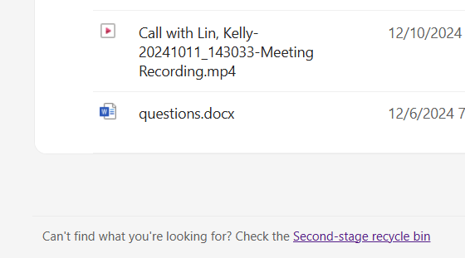
Second-stage Recycle Bin
The "super-secret-not-so-secret" bin

Slide 16
Quick Recap
If I am using Word to draft a department-wide email, where do I save this file?
OneDrive
If I am creating a spreadsheet to graph the number of students that visit our office to use our services over the last 5 years.
SharePoint

Slide 17
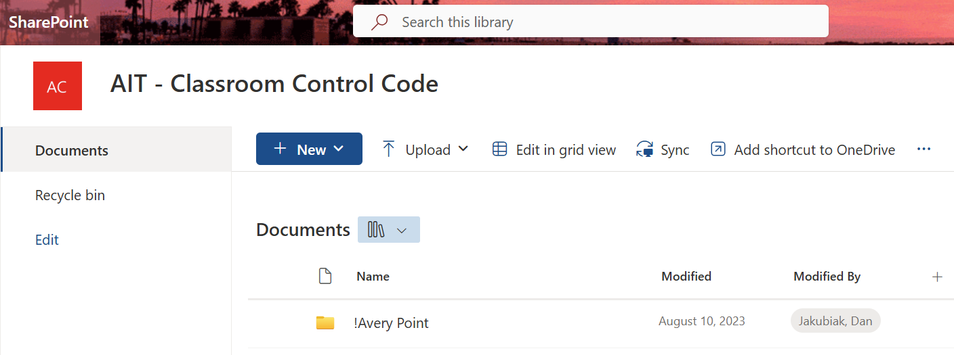
Connect SharePoint to OneDrive
One-time setup, visit s.uconn.edu/sharepoint

Slide 18
Connect SharePoint to OneDrive

Slide 19
Connect SharePoint to OneDrive

Slide 20
How do I go about saving files?
Two methods:
Open app and create file
Visit location and create file

Slide 21
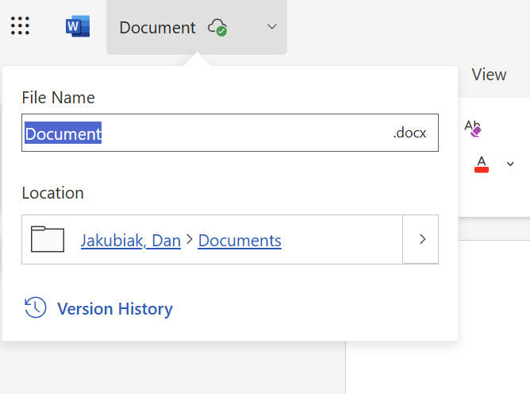
Open App first
Open Word
Click on the Document name
Notice that it was already saved to the Documents folder

Slide 22
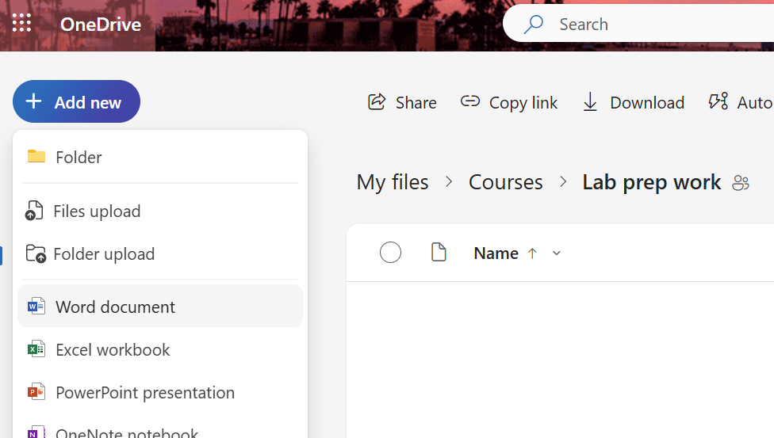
Visit location first
Visit s.uconn.edu/onedrive
Click on folders to enter them, find your location
Click on Add new

Slide 23
How do I find an existing file?
The search bar on every 365 website
Filename or contents of the file

Slide 24
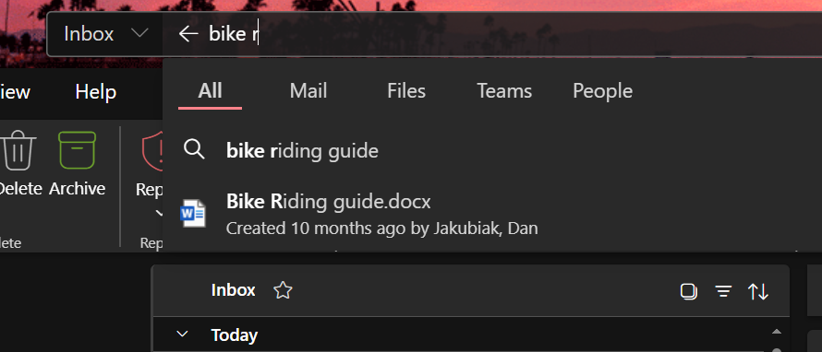

Slide 25
How do I find an existing file's location?
If you have a file open, but don't know where it sits in the cloud
Click on the file's name

Slide 26
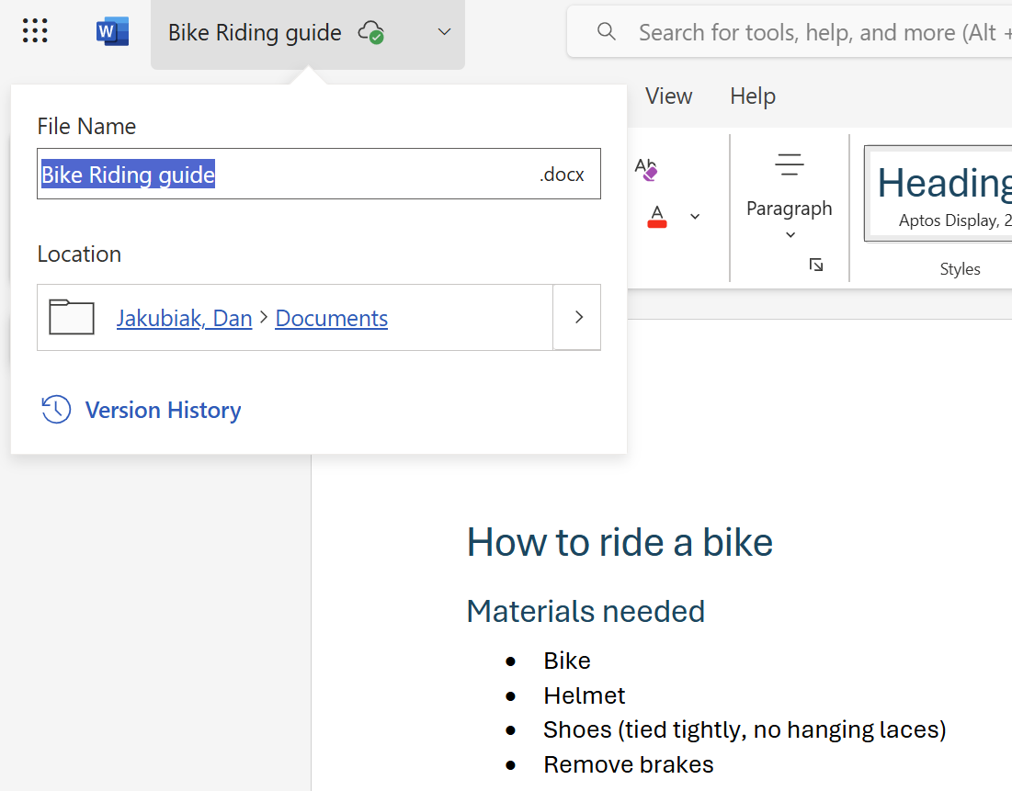

Slide 27
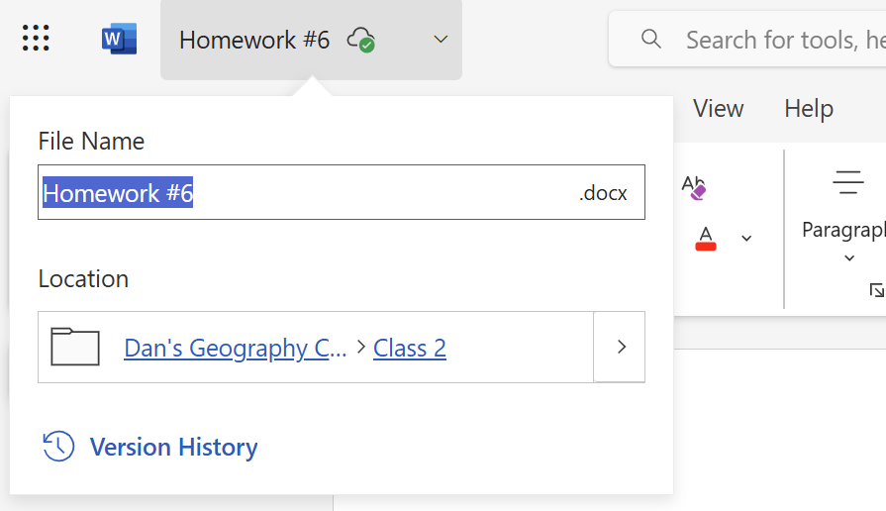

Slide 28
Questions?
Dan Jakubiak
techsupport@uconn.edu
s.uconn.edu/365
s.uconn.edu/onedrive
s.uconn.edu/onedrivehelp
s.uconn.edu/sharepoint
s.uconn.edu/sharepointhelp

