Slide 1
Digital Accessibility Create an Inclusive and Accessible Experience
Alt Text for Images

Slide 2
What is Alt Text?
Provides users with a brief yet informative description of the information conveyed by images such as photos, charts, graphs, maps, and infographics.
Alt text will populate on a webpage if an image doesn’t load.
Alt text is housed in the alt (alt=) attribute of an image in HTML content.
HTML for decorative images is alt="" (no space between quotes)
Alt text can be near the image when text equivalent cannot be presented succinctly, or it can be presented on a separate page.

Slide 3
Who Benefits from Alt Text?
Screen reader users
Screen readers may read out the file names for images that lack alt text
People with cognitive disabilities
Some individuals with cognitive disabilities may find an abundance of images distracting, overwhelming, or difficult to parse and process.
People with limited internet bandwidth
Individuals who turn off images to reduce page loading time can still understand their contents if alt text is displayed on the page.
Alt text boosts Search Engine Optimization
But prioritize accessibility over SEO

Slide 4
Quick Tips for Writing Effective Alt Text
Be accurate and equivalent (represent content and function)
Keep it concise (short)
Do not be redundant or provide the same information as text near the image
Do not include word Graphic or Image at the beginning
When a screen reader comes to an image, it will state, “Graphic” and then will read the alt text

Slide 5
What Are Examples of Barriers related to Alt Text?

Slide 6
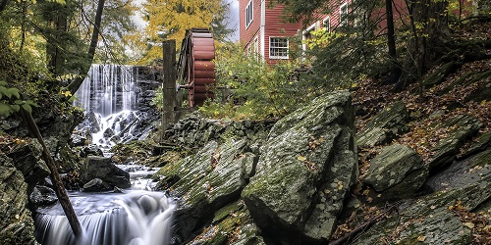
Inaccurate Alt Text
Alt Text: 20282.jpg (name of the file)

Slide 7
Not Reviewing Auto Generated Text
Alt Text:

Slide 8
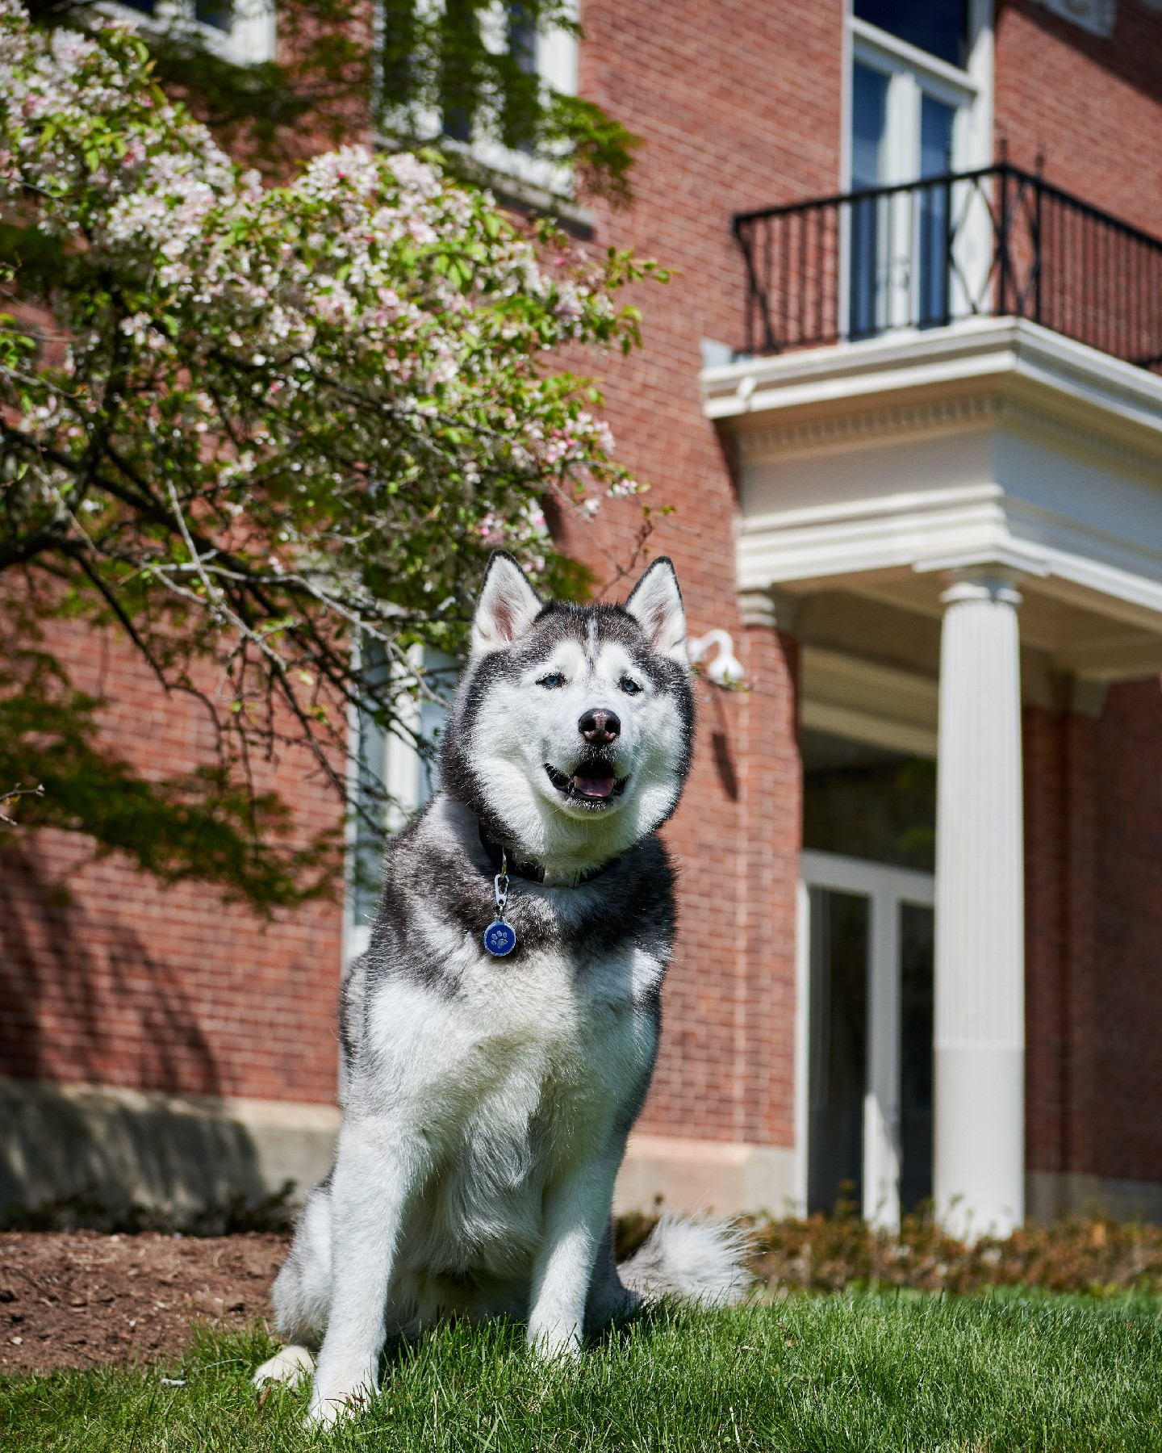
Marking an Image as Decorative
Does the image convey information?
Does the image evoke an emotion?

Slide 9
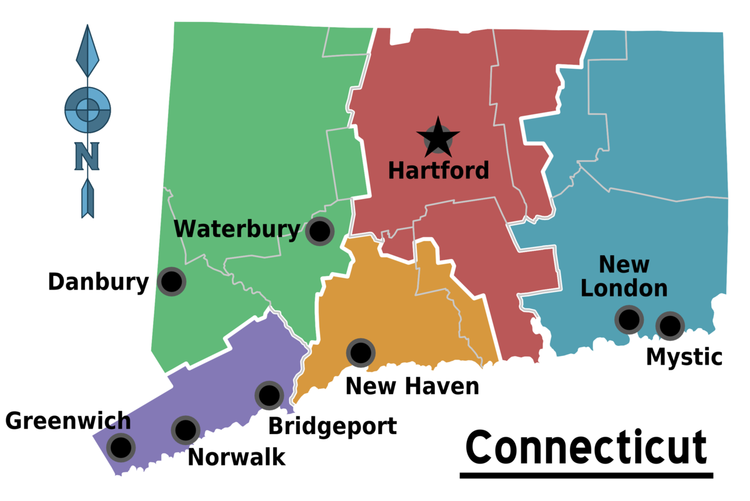
Not Providing Enough Information
Alt Text: Map of Connecticut

Slide 10
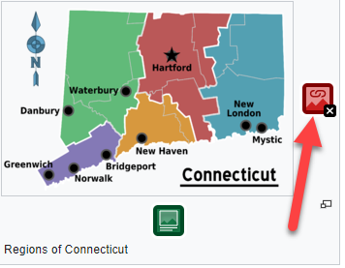
Linked Image without Alt Text
A linked image without alternative text results in an empty link.

Slide 11
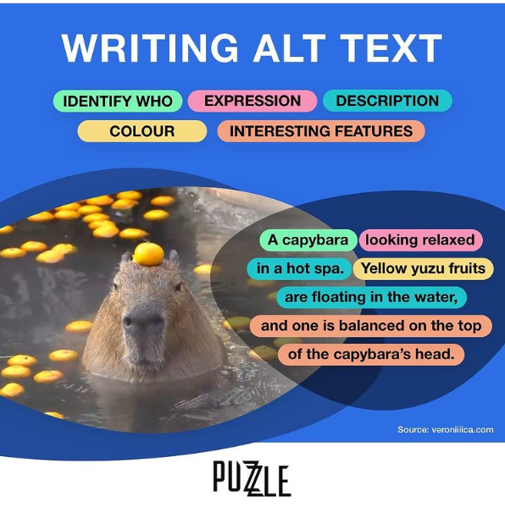
What to include when writing alt text and image descriptions
Type of image
Bar Chart, drawing, cartoon, screenshot, etc.
Text
All text should be written verbatim when it comes to transcribing text for alt text and image descriptions.
Who is in the image
Setting of the image
Color(s)
Use shade names such as cobalt blue, periwinkle, burgundy, lime green, metallic gold or
Describe item (i.e. green banana or yellow bell pepper)
Expression and emotions
Item locations and descriptions
Interesting details
Link to data or transcript
Source: Perkins.org

Slide 12
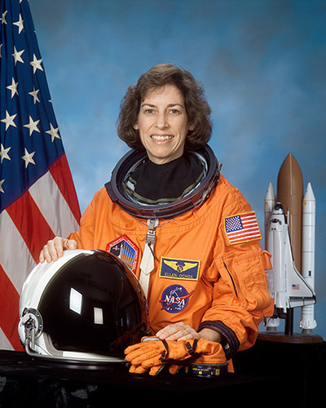
Example One
What would you choose as alt text for the image in Example 1?
"Astronaut Ellen Ochoa"
"Image of Ellen Ochoa, Astronaut"
"Ellen Ochoa, the first Hispanic woman to go into space"
Empty alt attribute (alt="" )
As the first Hispanic woman to go to space, and, later, the first Hispanic director of Johnson Space Center, Ellen Ochoa is widely regarded as a role model.
Notes:
First, consider its content and function. An image only has a function if it is linked (or has an <area> within a <map>), or if it's in a <button> . In this case, the image does not have a function.
Assessing and summarizing an image's content can be more difficult. If the image's content is presented within the surrounding text, then alt="" may be all that's needed.
In the example above, the image content informs the user that this is Ellen Ochoa. Her mode of dress further conveys that she is an astronaut—which is meaningful, given her achievements.
Based on this, we recommend alt="Astronaut Ellen Ochoa".
"Image of Ellen Ochoa, Astronaut" redundantly describes the image as an image.
"Ellen Ochoa, the first Hispanic woman to go into space" includes information that is not part of the image, and is also redundant with the body text.
An empty alt attribute is not appropriate either. Even though the body text names Ellen Ochoa, visual users can tell this directly from the content of the image—and so, since the image conveys content, it needs more than an empty alt attribute.

Slide 13
Example Two
What alt text would you choose for the icon image in Example 4? Note that the icon is within the link.
"Employment application"
"PDF"
"PDF icon"
The content of the image is presented in context, so alt="" is appropriate.
Download the employment application
Notes:
The image is also a link, so it has a function. Since no adjacent text within the link describes the link's function, it must be conveyed within the image alt attribute.
"PDF" is the best choice. This conveys the content of the icon—no more, no less.
"Employment application" would be redundant. The function ("Download the employment application") is presented within the text of the link, so it does not need to be included again within the alt attribute.
"PDF icon" describes what the image looks like, but it is not the most appropriate for this context—"icon" is redundant here. (If this icon were used in a different context, it may be important that the user know that it is an icon.)
Empty alt text would omit the important information that the image presents—that the link is to a PDF document.
If the icon alone was linked without the adjacent text, then the alt text would need to fully convey the content and function of the link/image combination: alt="Download the employment application in PDF format". "PDF format" alone would not be sufficient for the linked icon, especially if the page includes many PDF links and icons—a screen reader user navigating through the linked icons would hear, "PDF format, PDF format, PDF format..."
"Wikipedia entry for Ellen Ochoa, Astronaut" provides content other than that conveyed by the image—the fact the link goes to Wikipedia.
"Read More" does not provide enough information, especially out of context.
Empty alt text would never be appropriate here. When an image is the only content inside a link or button, alt text is all that a screen reader has to go on. If it's empty or missing, screen readers might read the image filename or the URL of the linked page in hopes that this may be helpful to the user, but this is not always the case.
This example would be more accessible for all users if both the image and the text caption were contained within one link:

Slide 14
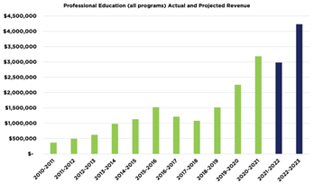
Graphs and Charts
Looking for 2-3 sentences that include the following using this graph as an example:
What is it and what is it showing? Bar graph showing actual and projected revenue for professional education.
What are the axis values? The graph shows millions of dollars in revenue from 2010 through 2023.
What is the trend or main takeaway? This is where you need to explain what they want to convey. Maybe it’s something like, Revenue has been steadily increasing each year from about 475,000 dollars in 2010 with a projected revenue of about 4.25 million dollars in 2023.
Alt-text for this graph could be: Bar graph showing actual and projected revenue for professional education. The graph shows millions of dollars in revenue from 2010 through 2023. Revenue has been steadily increasing each year from about 475,000 dollars in 2010 with a projected revenue of about 4.25 million dollars in 2023.

Slide 15
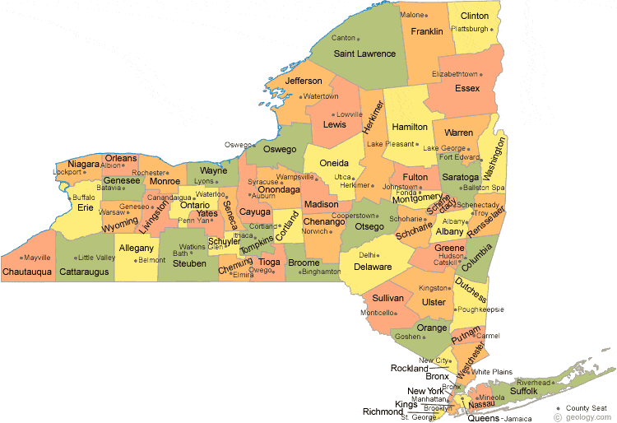
Maps
Must convey the content that is presented within the image. For instance, a State of New York map that has an <area> for each county might have alt="Counties of New York".
Each <area> must also have an equivalent alt attribute, because each <area> provides a function. For a New York counties image map, each <area alt> would contain the name of the county.
By contrast, server-side image maps (which pass mouse click coordinates back to the server for interpretation) are not perceivable by screen readers and are inoperable by keyboard and screen reader users. Server-side image maps should be replaced by client-side image maps.

Slide 16
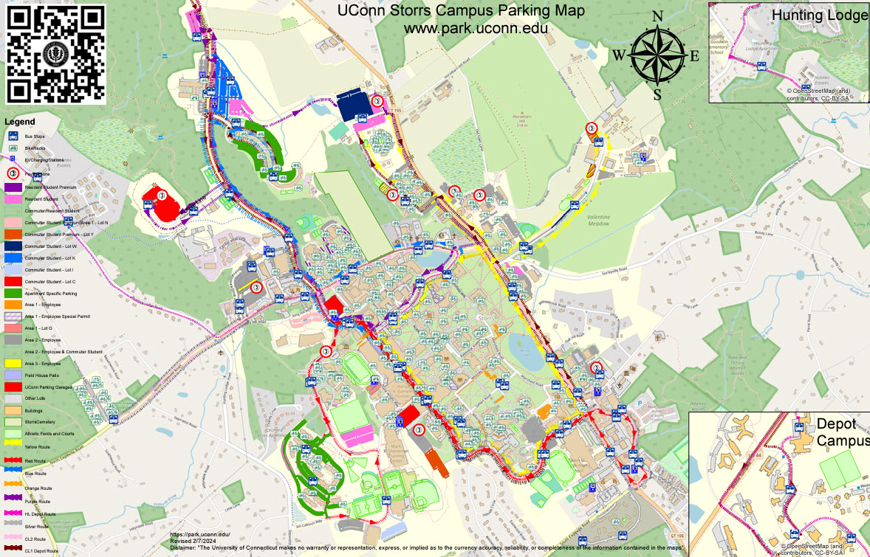
Map: Example
Possible Alt Text: Parking Map of UConn Storrs, CT for visitors, students, and employees, with bus routes highlighted. If you need more information, please call (860) 486-4930 Monday through Friday 8:00 AM to 4:00 PM.

Slide 17
Social Media Policies for Alt Text
X (Twitter) supports alt text up to 1,000 characters, though alt text cannot be added or edited after an image or gif is posted, unless you have a X Premium. How to add alt text when posting on X.
Instagram has no limit on the number of characters, and alt text can be added or edited after a picture is posted.
Facebook has no limit on the number of characters, and alt text can be added or edited after a picture is posted.
Facebook’s Automatic Alt Text (AAT) technology uses computer vision and artificial intelligence to automatically create a description of the image. The automatic alt text may not always be complete, but you can edit the alt text for images you upload or post.
Source: Perkins.org

Slide 18
Basic Accessibility Checklist for Alt Text
Do not start alt text with “picture of” or “graphic of”
Alt text is accurate (not file name)
Validate auto-generated alt text
Include enough information for end user
Exclude information found near the image (i.e. caption below image)
Include alt text of images with hyperlink
Alt text can vary for same image based on context
Graphs/Charts and maps are more complex
Ask content creator (person who wants to use the image) to write the alt text

Slide 19
Accessible Colors

Slide 20
Who do accessible colors affect?
People with low vision
People who are colorblind
Red / Green
Blue / Yellow
Complete color deficiency

Slide 21
Examples: Red/Green Deficiency
Red
Red

Slide 22
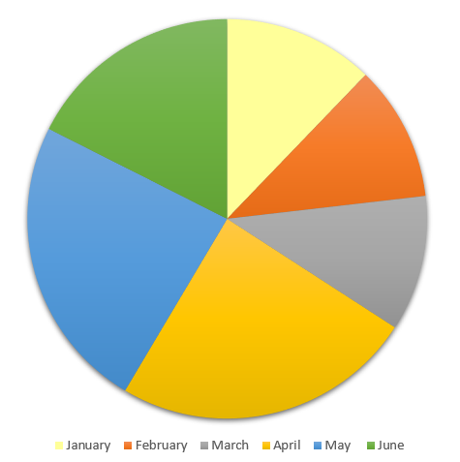
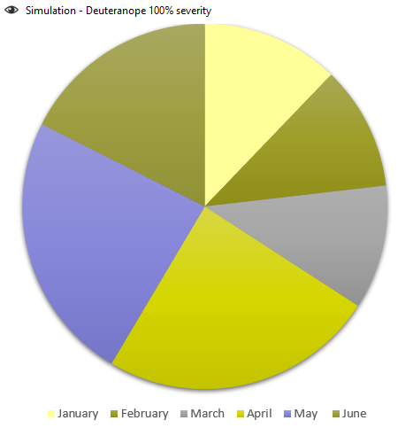
Inaccessible Pie Chart Only Using Color to Convey Information: Red/Green Deficiency

Slide 23
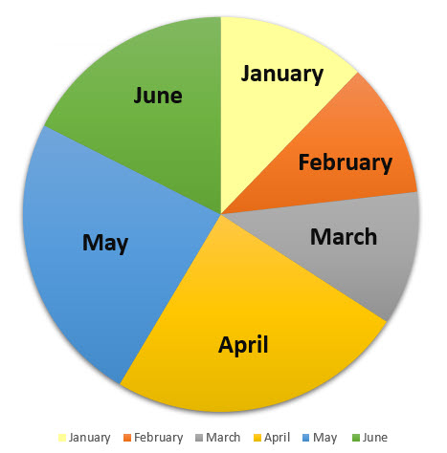
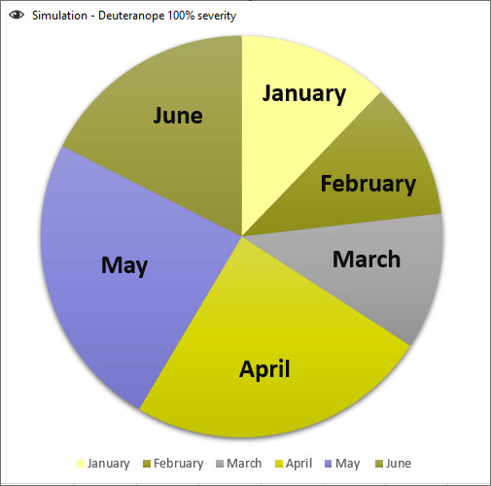
Accessible Pie Chart – Red/Green Deficiency

Slide 24
Color Contrast Requirements by Font Size
Font size 18+ (14, if bold) requires a contrast ratio of 3:1
Smaller font sizes require a contrast ratio of 4.5:1
This is 18 pt font and it passes at 3.11
This is 18 pt font and it passes at 4.5:1
This is 16 pt font and it fails at 3.11
This is 16 pt font and it passes at 4.5:1
This is 18 pt font and it passes at 4.2:1
This is 18 pt font and it passes at 4.5:1
This is 16 pt font and it fails at 4.2:1
This is 16 pt font and it passes at 4.5:1

Slide 25
Contrast Algorithms
The algorithms compare the two colors' relative luminance — which essentially boils down to whether one color is lighter or brighter than the other.
Here, tomato (ff6347) and cornflowerblue (6495ed) are pretty much equally bright, which is why they're difficult to read together.
You don’t want to read this.
The ratio for these two colors is a 1.009:1 which is barely better than comparing a color to itself (1:1).

Slide 26
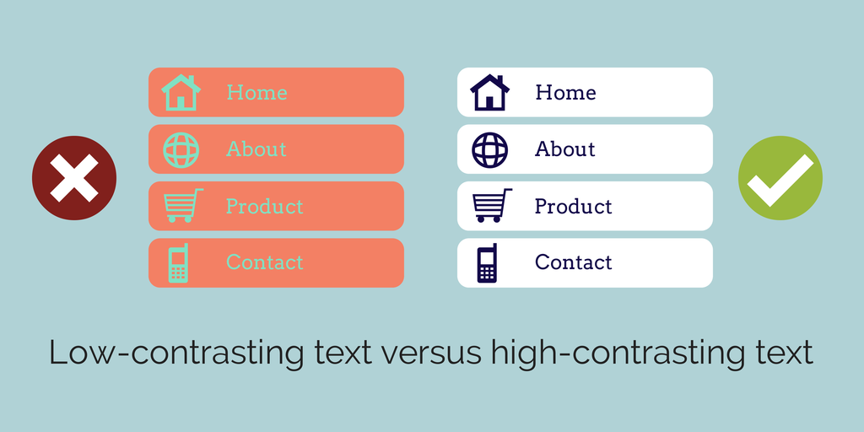
Text with Low Contrast

Slide 27
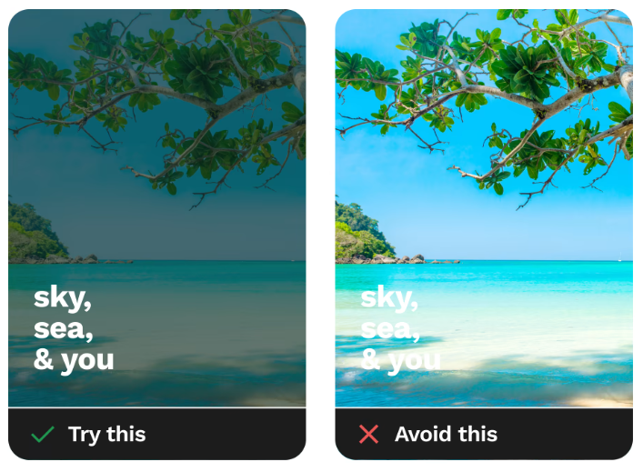
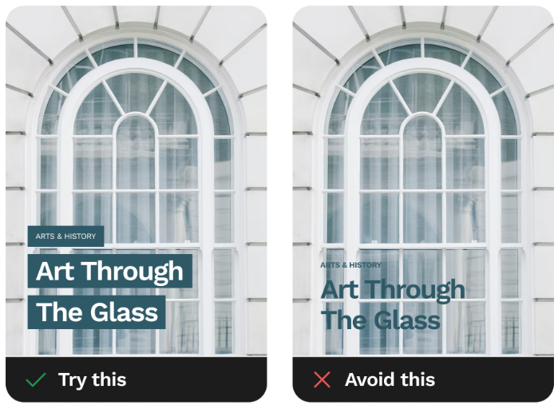
Text on Images: Dos and Don’ts
Source: https://www.smashingmagazine.com/2023/08/designing-accessible-text-over-images-part1/

Slide 28
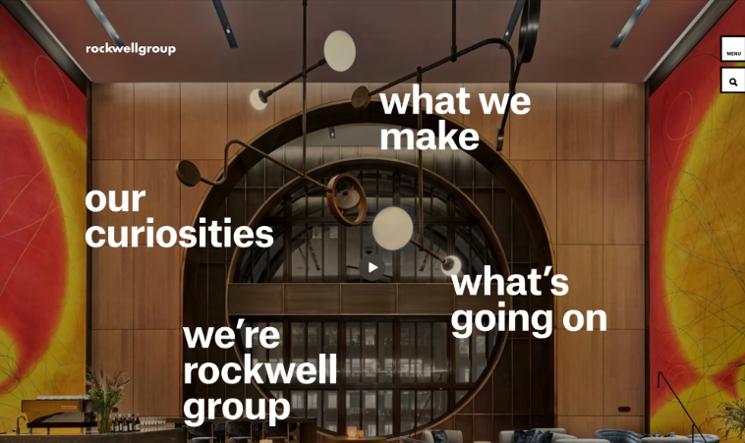
Text on Images that Work
Source: https://www.smashingmagazine.com/2023/08/designing-accessible-text-over-images-part1/

Slide 29
Basic Accessibility Checklist for Colors
Contrast Font 18 and higher 3:1
Contrast Font below 18 4.5:1
Do not use color alone to convey information
Avoid using Red and Black or Red and Green Combination
Text on Images
Use tools to check color contrast and simulate color blindness

Slide 30
Tools to Check for Accessibility

Slide 31
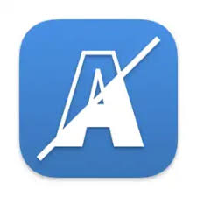
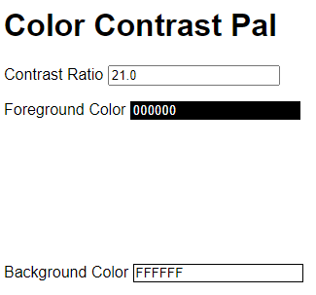
Tools for Color Contrast
Colour Contrast Analyser
WebAIM Website
Contrast Grid
Color Contrast Pal
Color Simulations

Slide 32
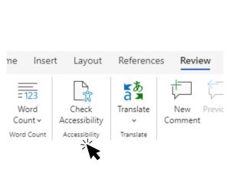
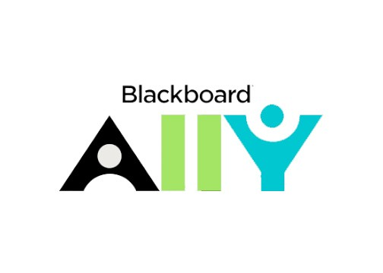
Tools to Check Word and PowerPoint
Microsoft Office Accessibility Tool
Review > Check Accessibility
Blackboard Ally (if you have access to a Bb course or organization)

