Slide 1
Records Management: Necessary but not evil betsy Pittman 3 June 2025

Slide 2
https://rim.uconn.edu

Slide 3
AGENDA: 5 Ws and an H
What is Records Management?
Why?
Who?
Where?
When?
How?

Slide 4
What is Records Management?

Slide 5
Life cycle of Records

Slide 6
Why is Records Management important and Why Should I practice it?

Slide 7
Why is records management important?
As a state and University employee…
…any document, regardless of format has the potential to be the copy of record of a state document.
…the copy of record of state documents are subject to specific retention periods.
…the destruction of state documents requires approval from the University Records Management Liaison Officer and the Office of Public Records.
…it’s University policy [https://policy.uconn.edu/2011/05/24/records-management-policy/]*
*policy currently under revision

Slide 8
What is “copy of record”?
Authorized Signature
Enterprise-wide
Questions to ask yourself
Concur
KFS
PeopleSoft
Core-CT
Others?
When signed by final signatory (whoever that may be)
Something is purchased
Someone is hired
Work moves forward
Are you the final signatory?
Did something happen when you or your office completed the action the form represents?
Was a check cut?
Was a decision determined?
Was this the final communication?

Slide 9
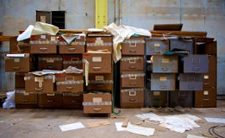
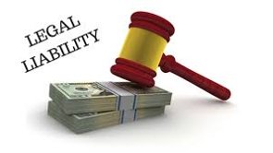
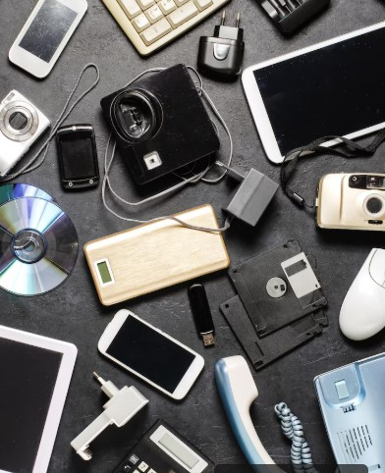
Why should i?
Minimize legal liability and potential hacks
Increase efficiency in managing and locating documents
Reduce space needs for storage
Reduce space needs for storage

Slide 10
Who is responsible?

Slide 11
Every Uconn/Uconn Health employee

Slide 12
Where?

Slide 13
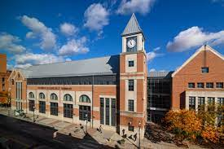
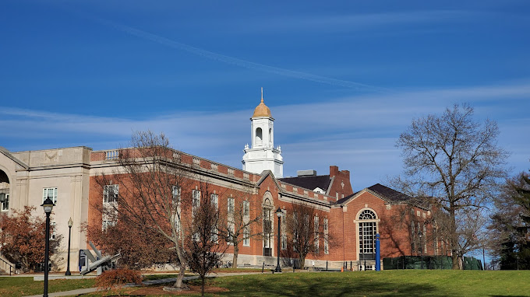
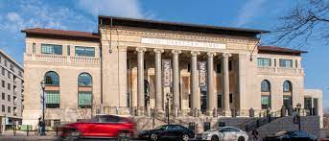
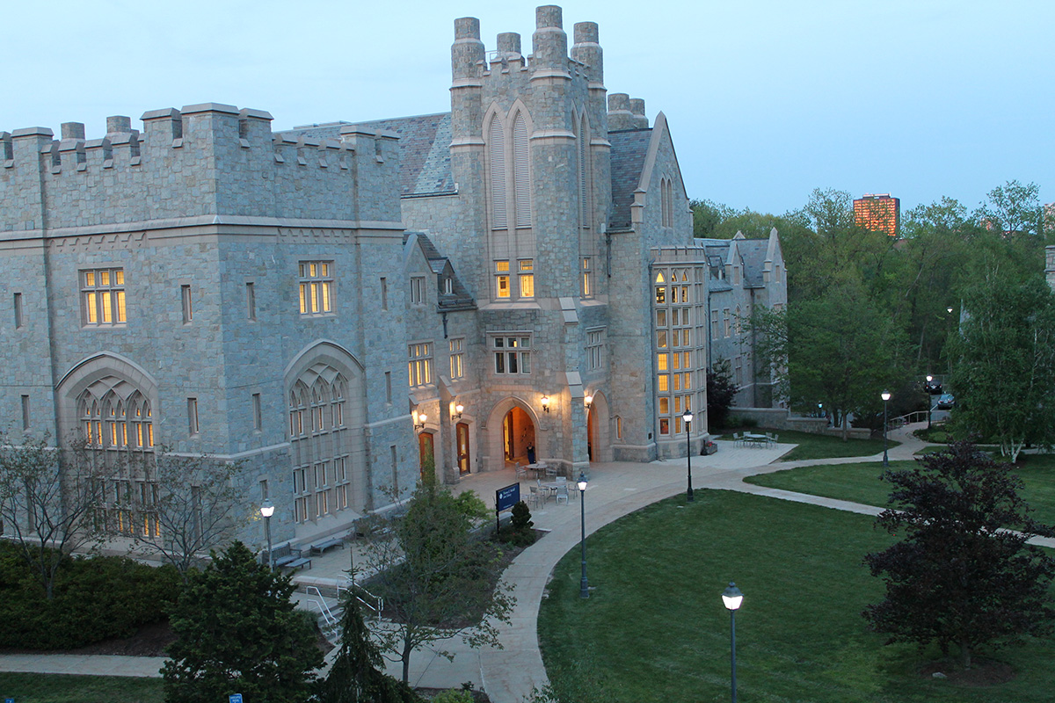
All Uconn/uconn health units including programs such as Cooperative Extension, Centers, Institutes and similar programs.

Slide 14
When should I “do” records management?

Slide 15
Incorporate rm into unit workflows where possible Practice evaluating…do i have the copy of record? Is this still current/in use? Do I need permission to destroy?
Email
SharePoint
Enterprise-wide systems (KFS, Concur, PeopleSoft, Core-CT, Job-X)
Manual files and storage spaces
Establish a schedule that works for the unit to regularly submit requests for disposition (destruction)

Slide 16
How do I “do” records management?

Slide 17
“Doing” Records Management
Evaluate current filing and naming practices
Inventory storage spaces and “old files”
Inventory electronic storages spaces and migrated files (P drives)
Review general and higher educations retention schedules
Identify enterprise-wide systems that are used regularly
Use the recent mandate to reduce OneDrive storage as practice

Slide 18
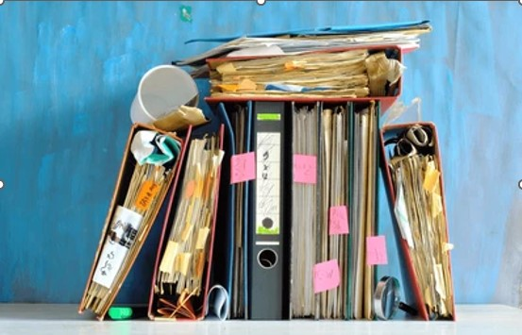
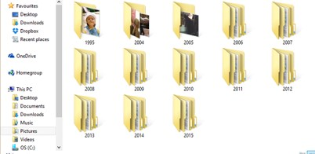
Management of erecords: Born Digital or digitized
Records Management doesn’t care.
Function that determines the retention
Structured organization makes the difference

Slide 19
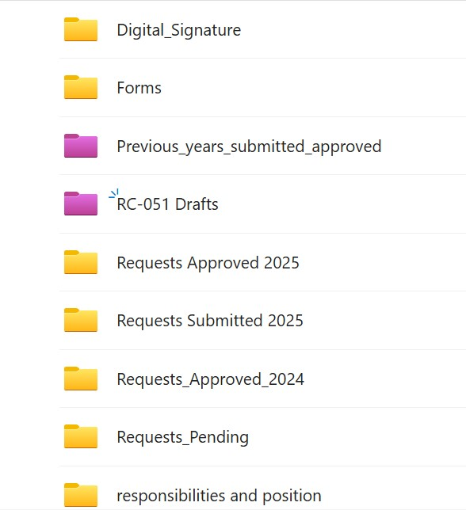
Examples

Slide 20
Recordkeeping and data privacy
Need to keep track?
Create a spreadsheet or document
Essential elements of information
No credit card numbers
No social security numbers
No payment information
No contact information
Authorized access only in shared space
Award and scholarship recipients
Very Important People or Dates
Graduates
Past Vendors

Slide 21
Final tips & takeaways
Consider how RM can work for you rather than become a necessary evil
Ask for help – Contacts are listed on the RIM website
Be consistent
Create a process for arranging records to support RM
Develop naming conventions and use them!

Slide 22
https://rim.uconn.edu

Slide 23
THANK YOU
betsy.pittman@uconn.edu https://rim.uconn.edu/contacts

