Slide 1


Mastering Microsoft 365:
Best Practices for Enhanced Efficiency
Presented by
Meera Nair

Slide 2

M365 services
Which services are you most interested in exploring further today?
Which services are you most interested in exploring further?

Slide 3
Outlook – Manage email smarter
Sweep messages
Conditional formatting
Clean Up Your Mailbox Efficiently
Flag email → Microsoft To Do

Slide 4
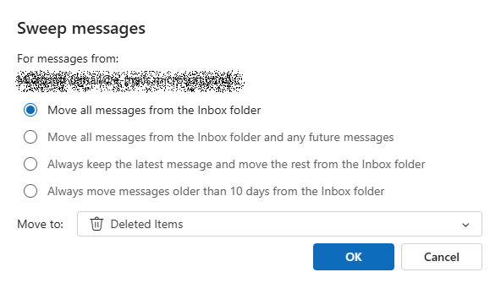
Sweep messages
  Delete all messages from a sender
  Keep only the recent one and delete the rest
  Always keep the recent one and delete older than 10 days
  For quick cleanup of recurring emails (like newsletters or reports)

Slide 5
Conditional formatting (Classic Outlook)
Apply conditional formatting on emails from high profile users
Create custom rules to highlight based on:
  Sender
  Subject keywords
  Importance level
Notes:
Conditional formatting: Classic Outlook → View tab → Current view→ View settings → Conditional Formatting

Slide 6
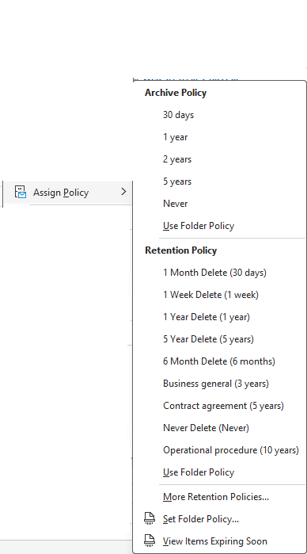
Retention Policies
Default Policy
  Move emails older than 2 years
  into the same folder in Archive Mailbox
Select the email / folder to modify from default
Click "Assign Policy"
Choose the appropriate retention label
Example: "Keep for 5 years", "Delete after 1 year").
Notes:
Archive policy moves emails to Archive mailbox. Does not delete
Retention policy decides how to long to retain the email and when to delete

Slide 7
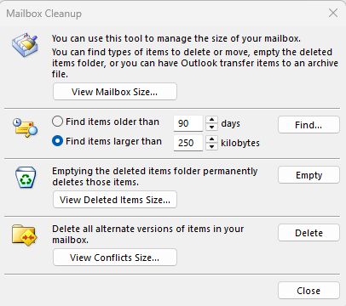
Clean up Mailbox
Sweep feature in the web
Retention Policies
Search and bulk delete from the web:
  hasattachments:yes
  larger:10MB
  from:YourAnnoyingColleague@uconn.edu
Use “Clean Up Folder” in Classic Outlook to
remove redundant emails in long threads
Use “Mailbox Cleanup” in Classic Outlook to:
  Find large messages
  View mailbox size
  Auto-archive old items
Notes:
File → Tools → Mailbox cleanup
removes duplicate or alternate versions of items (like emails, calendar entries, or tasks) that Outlook has kept due to synchronization conflicts
When:
When you edit an item on one device while it's being edited or synced on another.
If Outlook has trouble syncing changes due to connectivity issues.
Outlook saves conflicting versions in a hidden "Conflicts" folder or attaches them to the item.
What:
Deletes conflict versions of emails, calendar events, contacts, etc.
Keeps the latest or primary version of the item.
Helps reduce mailbox size and clean up clutter from sync issues.

Slide 8
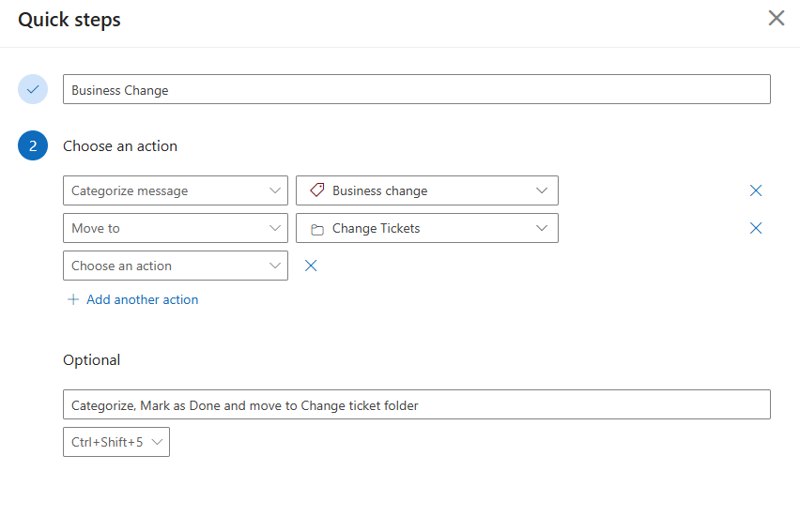
Quick Steps
Automate repetitive tasks
OWA & Classic Outlook

Slide 9
To Do – Stay Organized and Focused
Prioritize daily work
Track progress
Task List for pending list
Subtasks and Notes to add more detail to your task
Syncs with Outlook tasks

Slide 10
Optimize Teams
Add Apps to existing Team channels like Planner, custom apps, OneNote etc.
Increase Meeting efficiency:
  Enable Live Transcripts
  Meeting recap with recordings and shared files
  Enable Copilot (If licensed.)
Use Tags to @Group People
  Create custom tags like @DesignTeam or @Leads
  Message a group of people without creating a new channel or team

Slide 11
Teams Premium Features
Paid Add-on
Intelligent Recap with AI-Powered Notes
Timeline markers
Suggested tasks from conversation context
Advanced Meeting Customization
  Add UConn logo and custom backgrounds to meetings
  Branding appears in meeting lobby and interface
Watermark participant’s email on shared content to prevent data leaks
Deep analytics for meetings

Slide 12
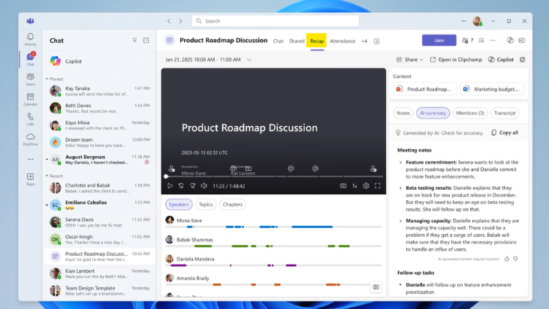

Slide 13
Power Automate
Automate repetitive tasks and workflows
Trigger actions from Outlook or Teams or Sharepoint etc.
Easy to navigate using pre-existing templates
Or create your own custom workflows

Slide 14
Sharepoint Online
Difference between Sharepoint Online and OneDrive
Create custom views for Easier Navigation
  Group by Files Modified this month or Pending Approvals etc.
  Set expiration dates on external shared links
  Manage access to adjust or revoke permissions quarterly
  Enable “request Access” for better control
🛠 Pro Tip: Avoid using “Anyone with the link” unless necessary

Slide 15
Sharepoint Online Contd.
Replace deeply nested folders with Metadata columns:
  Add metadata like Project Name, Department, Document type, Status etc.
  This helps to filter and sort easily
  Better visibility of files over folders
  Metadata can reveal pattern
    Single line of text – Simple tags
    Choice – Dropdown options (e.g., Status: Draft, Final)
    Date and time – For due dates..
    Person – To assign tasks
    Managed metadata – Connect to term store (enterprise tags)

Slide 16
Viva Insights
Access:
  https://insights.viva.office.com
  Open the Viva Insights app in Teams or Outlook
  Under apps from the web
Integrates seamlessly with Teams and other 365 services
Personal Insights
  Focus Time to Blocked calendar
  Wellbeing reminders
  Productivity recommendations
Notes:
designed to enhance employee productivity and well-being through data-driven insights

Slide 17
Demo Time !!
Notes:
Ask for demo users want to see:
Outlook:
Sweep / Quick Steps /Conditional formatting: View tab → View Settings > Conditional Formatting > Add Rule > Choose Font & Conditions
Archive Mailbox
Clean up mailbox: File > Tools > Mailbox Cleanup
New Email > Options > Delay Delivery
Teams:
Create Tag within Team with Meera and Demo2
Teams: Adding Planner to a channel and accessing transcripts
Teams: Apps > Power Automate > Browse templates or create a flow
Sharepoint Online: Show Sharepoint Lists, gallery etc. Show how to add Metadata
Viva Insights: Add to Teams and show Focus Time, etc.
If Time pemits:
PowerAutomate: TimeOffDemo
Power automate based of keyword in teams – approval
https://make.powerautomate.com/
New Flow → Automated Cloud Flow → Name the flow → Trigger (Teams search and look for keyword) → Create

Slide 18
Questions….

