Slide 1
Microsoft Approval Workflows
Bringing many Microsoft services together, using one automation platform
Joshua Z. Jones

Slide 2
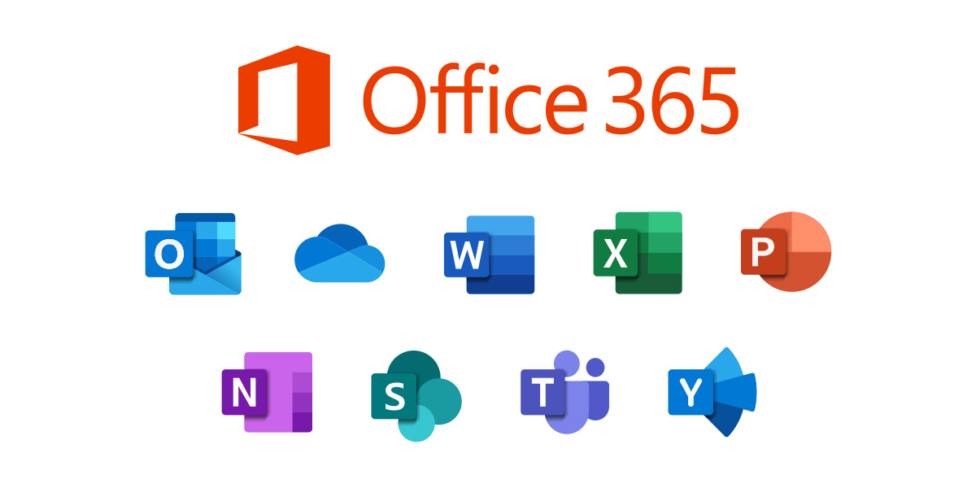
Microsoft Applications & Services
Outlook
Teams
SharePoint
OneDrive
Forms

Slide 3
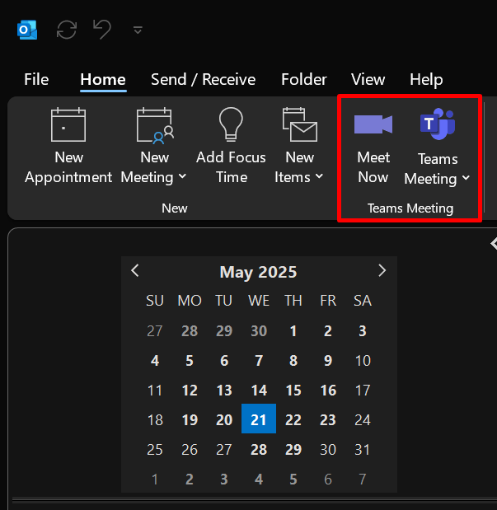
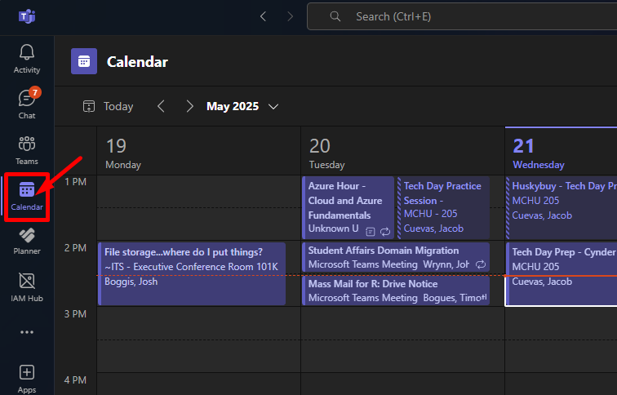
Simple Native Integrations
Outlook
Teams

Slide 4
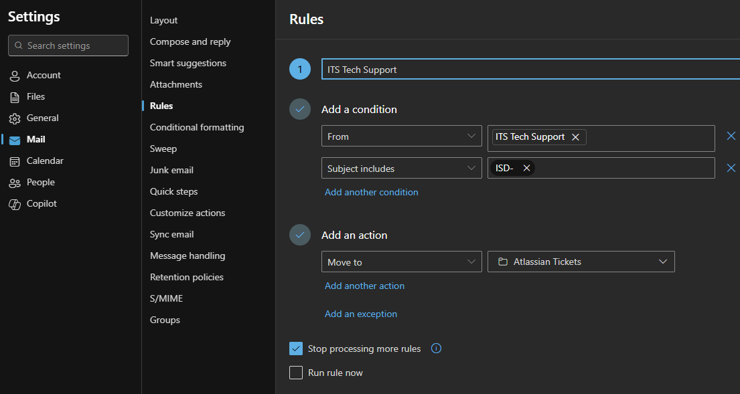
In-App Automation Rules

Slide 5
Power Automate
Low / no code solution
Integrated into nearly all Microsoft services
Automates monotonous processes
Available to everyone

Slide 6
Flows (Automated Processes)
Flows are started by triggers
Manually pressing a button
Receiving an email
Creating / modifying a file in SharePoint
Submitting a Microsoft Form

Slide 7
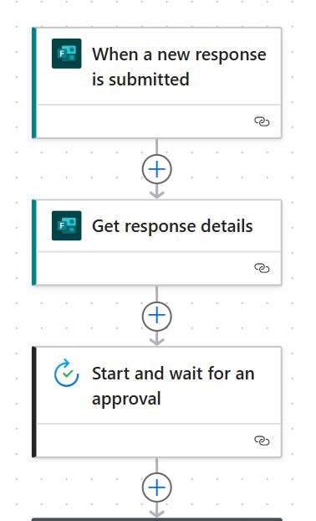
Action Cards Follow Triggers
Form is submitted ->
<- Trigger (start the Flow)
Obtain answers to the questions ->
<- First action card
Send an approval notification ->
<- Next action card

Slide 8
Approval Process Demo

Slide 9
Three Key Points
Triggers
What starts your Flow
Actions
What happens after your trigger
Dynamic Content
Reference content / data in each card, from any card

Slide 10
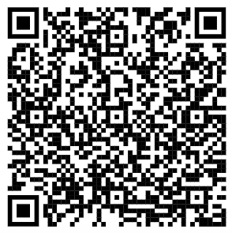
Questions?
MS Learn video on Power Automate

