Slide 1
Kuali Build Essentials
Jessica Henderson
Jordan Gardiner

Slide 2
That's Kuali not koala!

Slide 3
What is kuali build? No code forms & workflow for higher education
Form: Used to gather information
Workflow: Defines the steps that occur after the form is submitted
Documents: the completed and submitted forms
All these elements together,
are known as an App

Slide 4
Kuali Build Dashboard

Slide 5
Goal of this presentation
Share best practices to help you build smarter, more sustainable solutions.
Spotlight underutilized features that can greatly enhance your applications—making them more intuitive for end users, visually refined, and operationally efficient.
Review common mistakes and frequently asked questions to help you avoid pitfalls and streamline your development process in Kuali Build.

Slide 6
Agenda
Sections
Gadget Labels
Data Lookups
Conditional Permissions
Testing: Form Preview and Workflow Simulator
App Permissions
Groups
Tips

Slide 7
Sections
Provides Natural Breaks
Creates Pages
Permissions / Office use only sections
Conditional logic for entire sections

Slide 8
Gadget Labeling
Clearly label your fields to facilitate easier identification
Document List filtering
Workflow Step config - Identify Sections
Custom email variables

Slide 9
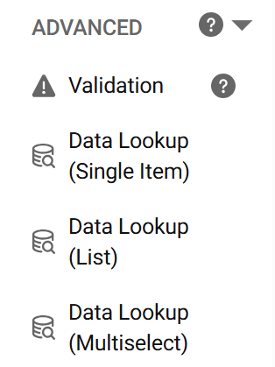
Improved user experience with Data Look-Up's
Connect to data sources
Automatically populate form fields
Ensure accuracy

Slide 10
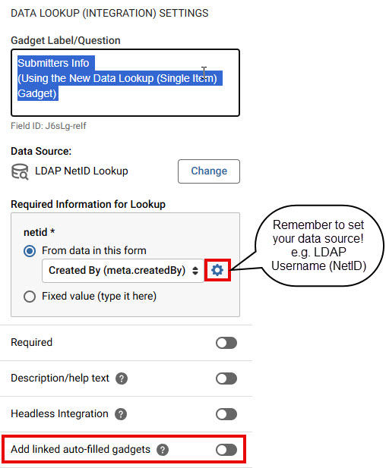
Data Lookup (Single Item) Gadget
Auto-populate form submitters contact information!!
Auto-populate contact info based on your NetID

Slide 11
Use 'Add linked auto-filled gadgets setting' with data lookup (single item) gadget

Slide 12
Data Lookup (Single Item): Prepopulate Your Form

Slide 13
Data look-up (List)
Data lookup (list) – Select a single item from a dropdown menu
Select your source:
University Department List
Another Kuali Build app (Data Sharing)
Other
Select Department from list

Slide 14
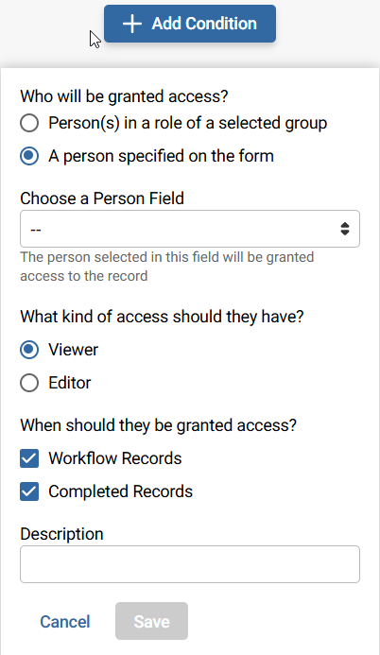
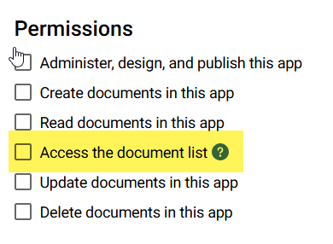
CONDITIONAL PERMISSIONS
Allows workflow participants access to specific records in the Documents List

Slide 15
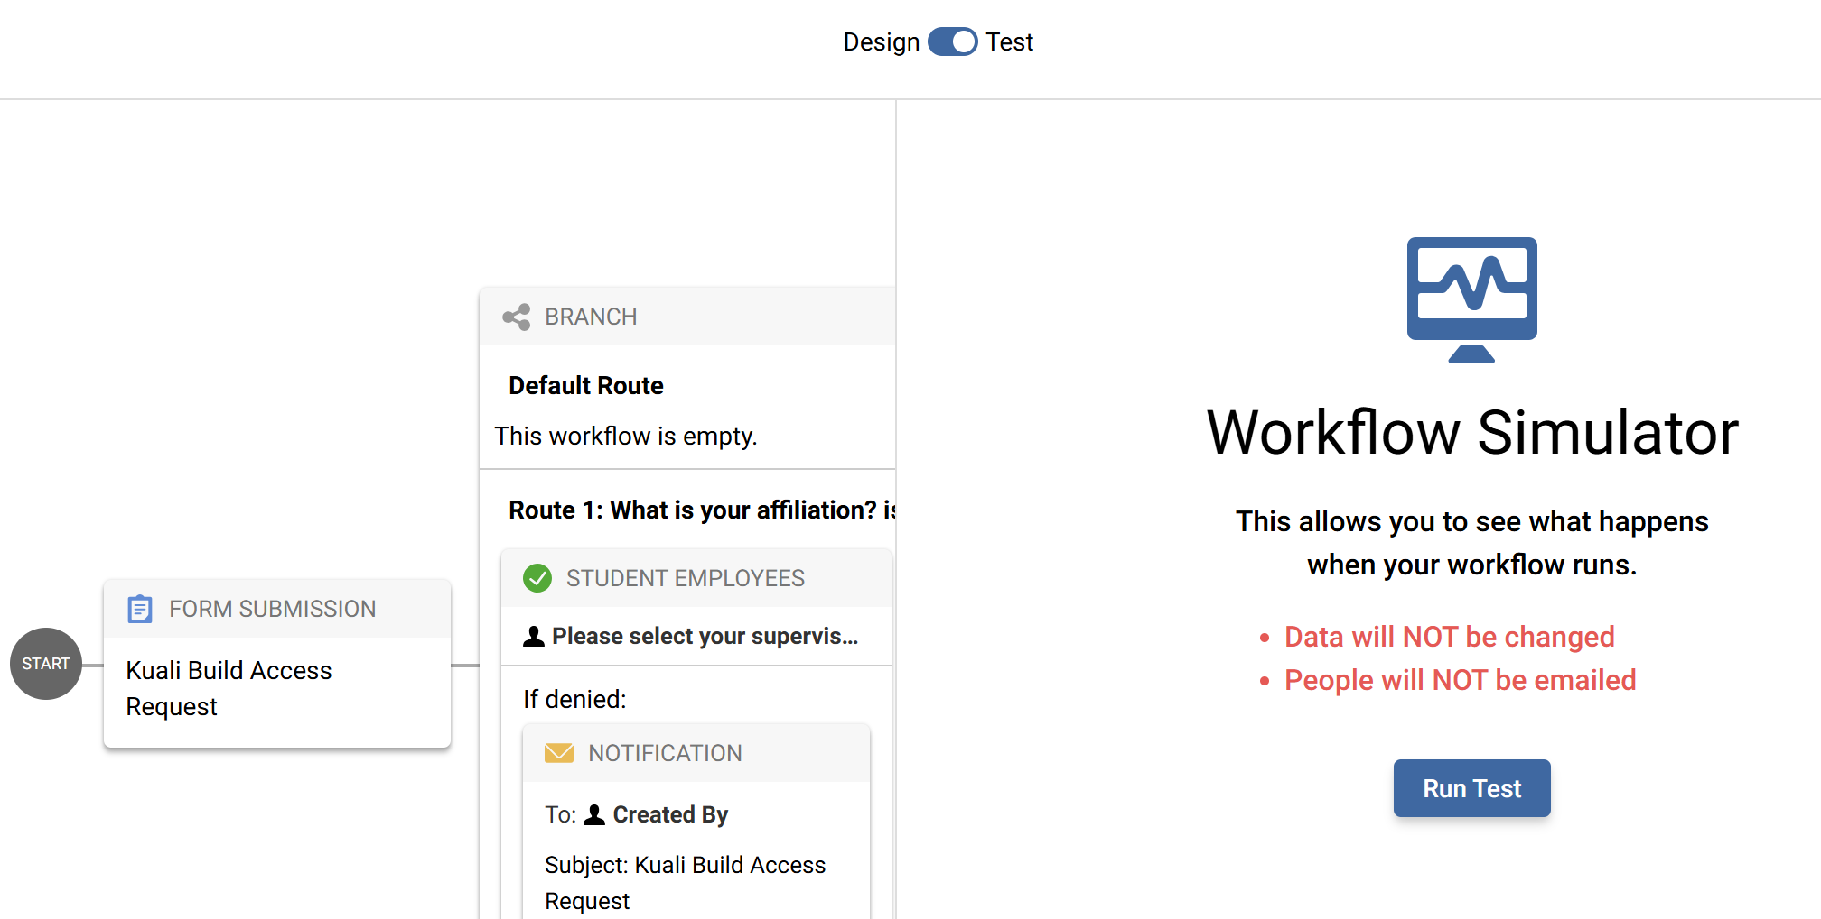
TESTING
Use Form Preview
Use the simulator – no data, no emails
Share with a small test group & test
Any integrations
Gather feedback, tweak before rollout

Slide 16
Always set your app permissions!
Assign Permissions to Roles
●Permission Options
○ Administer, design, and publish
○ Create documents
○ Read documents
○ Access the document list (*Conditional Permissions)
○ Update documents
○ Delete documents
Roles
● App Admins
● All Authenticated Users
Applies to all users in the system with an active NetID
● All Anonymous Users
Anyone can create documents
● Create your own custom role

Slide 17
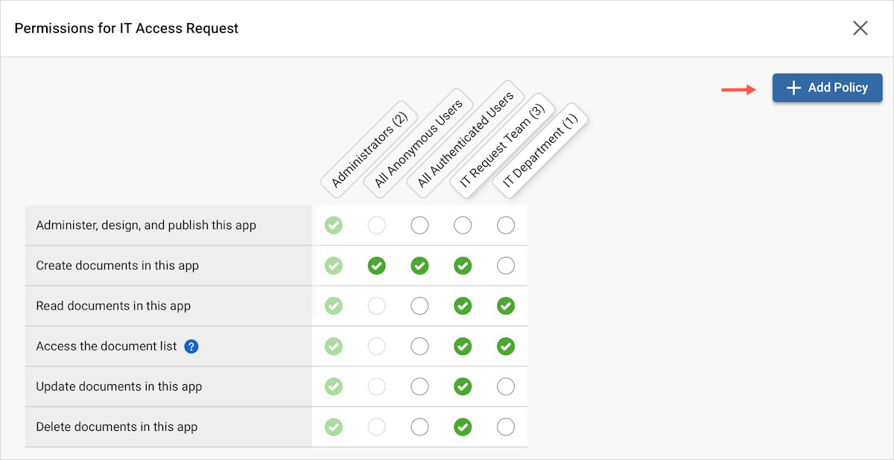
APP PERMISSIONS REDESIGN
Coming on June 9th!
Add New 'Role' Now Add 'Policy'

Slide 18
Important for structure, security and automation
Custom Groups
Use in Workflow, on Forms and App Permissions
Utilize delegated group administration
Define group membership and roles

Slide 19
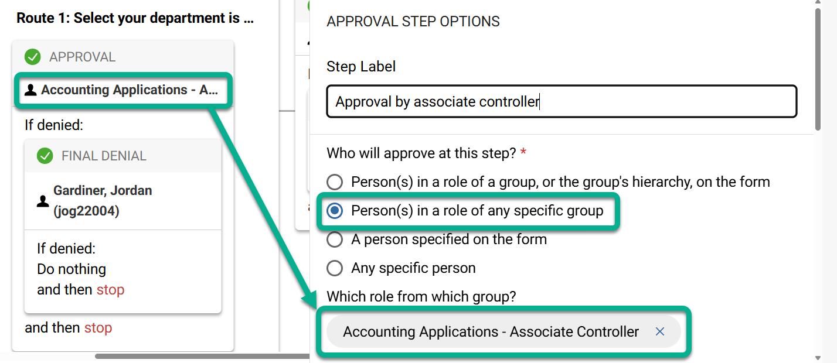
Using Groups in Workflow
Workflow automation assigns steps based on role associations
dynamically route approvals to people or groups

Slide 20
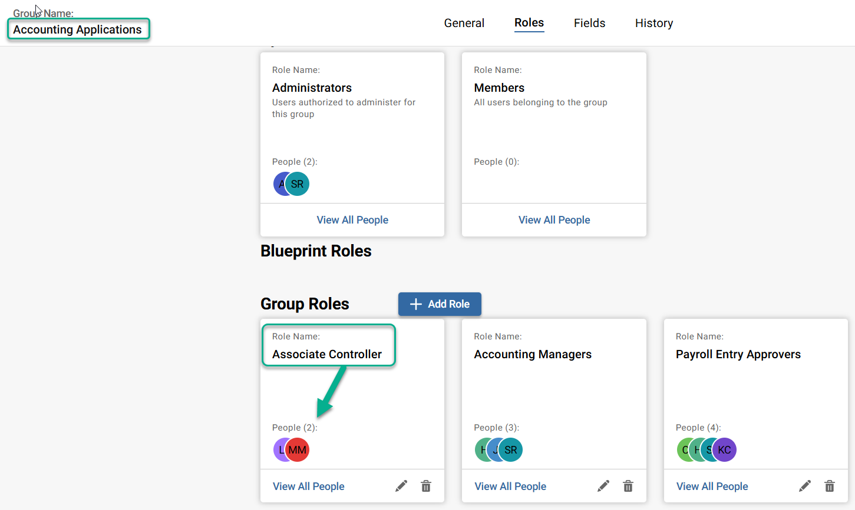
Group Administration
Assign people to roles within a group
Manage your own custom groups for one or many apps
Add, edit, or delete roles and associated membership
Request a custom group that you can manage!

Slide 21
Form Design TIPS
User focused
Reduce effort – leverage auto fill
Keep it clear – avoid technical jargon and acronyms
Include help text only when it is needed to provide clarity
Arrange questions / visibility in a logical sequence
Group related fields into sections
Use Multiple Choice gadgets for Yes/No responses
Check box gadgets will allow both selections

Slide 22
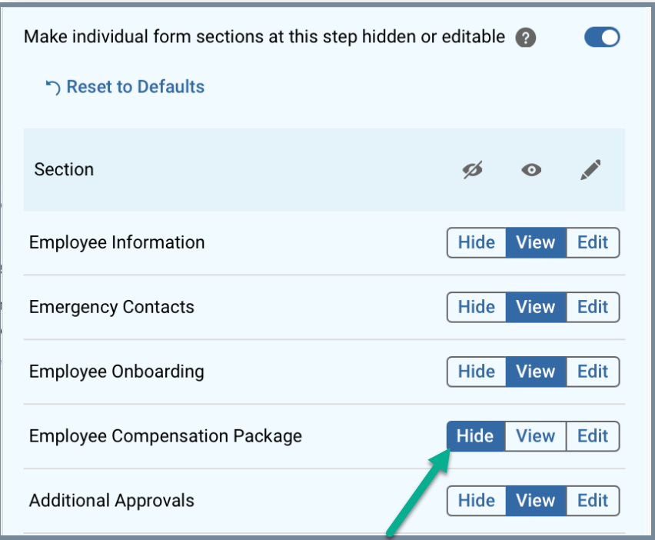
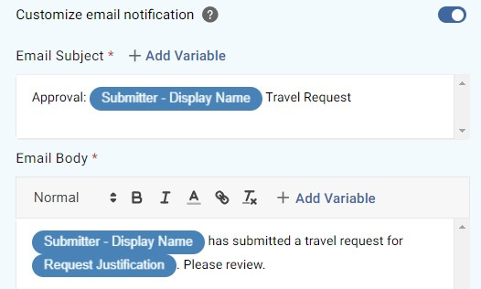
Workflow tips
Customize your email notifications using variables
Hide/show sections of the form
based on the current workflow step
Configure visibility during workflow steps

Slide 23
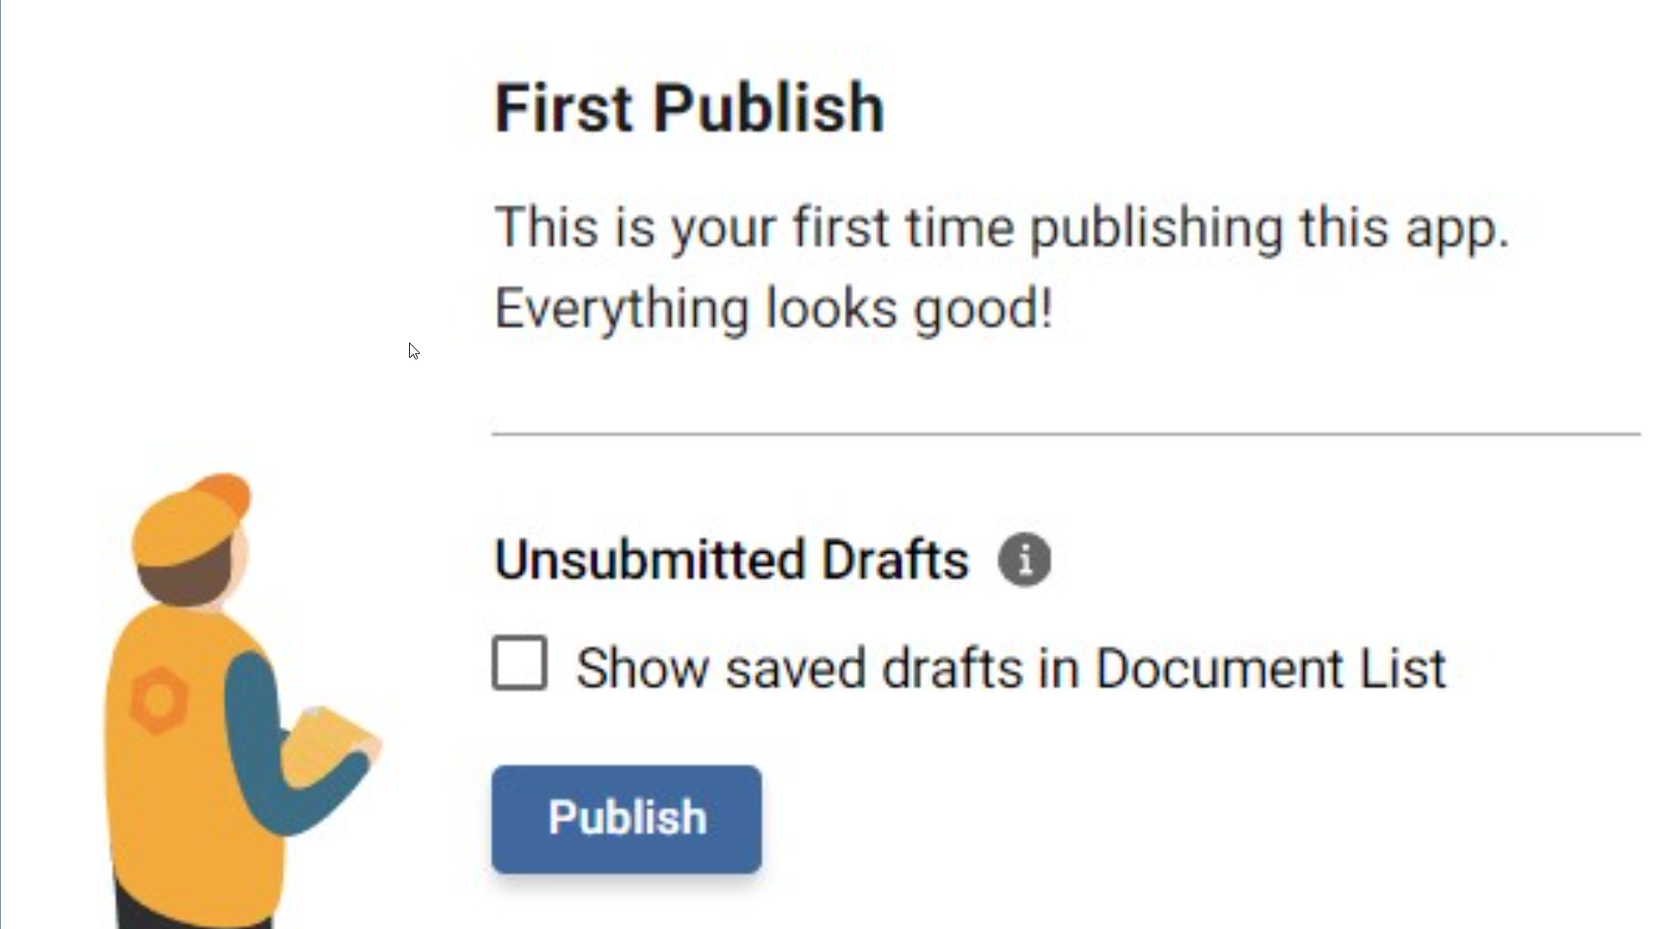
PUBLISHING tips
Be mindful of app versioning
Consider:
Duplicating your App
App naming conventions
You have ONE opportunity to show unsubmitted drafts in the Documents List (upon First Publish)
If app is student facing, do not enable this feature (FERPA)

Slide 24
Visit the Kuali Build Knowledge Base
Learn how to build an app, administer groups and manage submissions (Document List)

Slide 25
Contact us!
Contact ITS Kuali Build Support with questions
Visit the Technology Support Center Portal
Email techsupport@uconn.edu
Call 860-486-4357
Help us help you! Include the name of your app

Slide 26
Questions?

Slide 27
Thank you!

