Slide 1
What's New in Kuali Build? Jordan Gardiner Jessica Henderson

Slide 2
Goals of this presentation
Highlight recently released features that are especially valuable for experienced Kuali Build users.
Cover key enhancements, expanded data access, and user interface improvements designed to provide a more seamless and intuitive user experience.
Explore new capabilities that empower app administrators to better analyze and manage processes.

Slide 3
Agenda
What's New in App Management
Links in Spaces
Build Insights Dashboard
App Permissions Redesign
What's New in the Document List
Document List Filter and Views Redesign
What's New in Forms
Read only image
Limit Submissions
Validation Gadget
Autocomplete for Gadgets
Additional Data Lookup Input Options
New PDF Experience
What's New in Workflow
Workflow Notifications History
Configurable Send Back

Slide 4
What's New in Kuali Build?

Slide 5
What's New in App Management?

Slide 6
Admin Dashboard
Provides pre-configured reports to track metrics for the given app.
Reduce bottlenecks
Admins can quickly track:
Submission volume
Documents that may be languishing in workflow
Recent actions

Slide 7
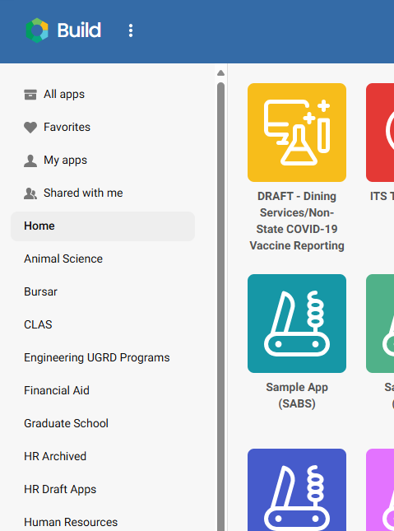
Links in Spaces
Add custom links and images that will display above the apps within a Space

Slide 8
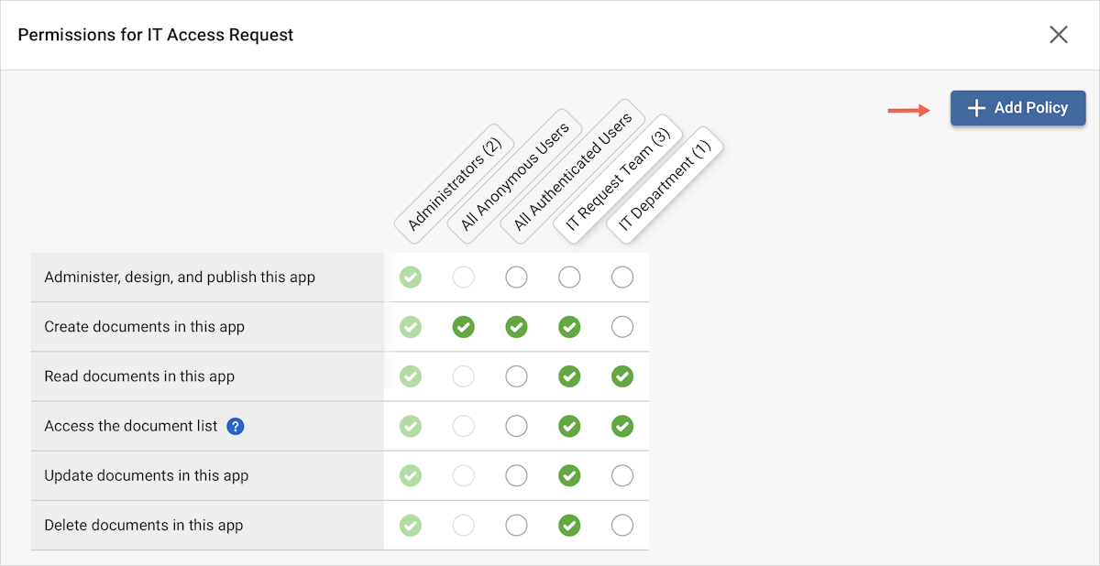
APP PERMISSIONS REDESIGN
Coming on June 9th!
Add New 'Role' Now Add 'Policy'

Slide 9
What's New in the DOCUMENT LIST?
Document List Filter & Views Redesign

Slide 10
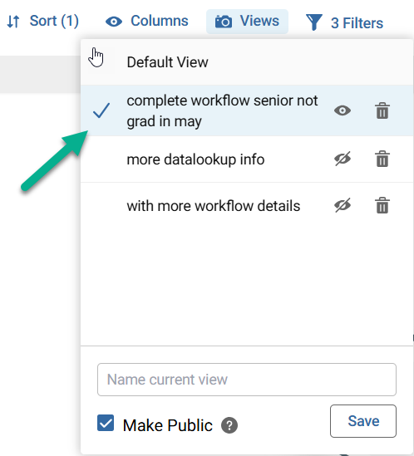
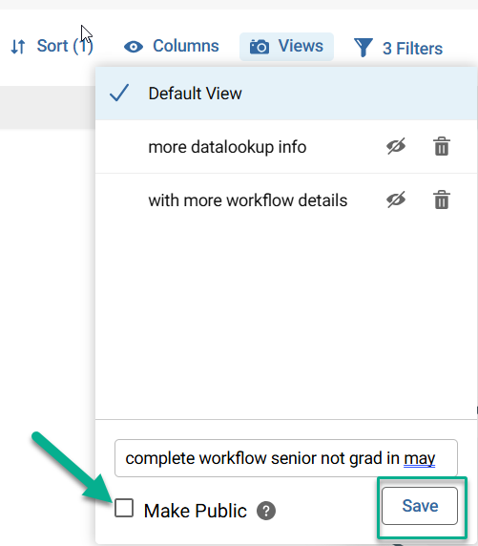
Document List – Shared Views
Use advanced filtering to create views Save and share pre-configured views with other users

Slide 11
What's New in FORMS?

Slide 12
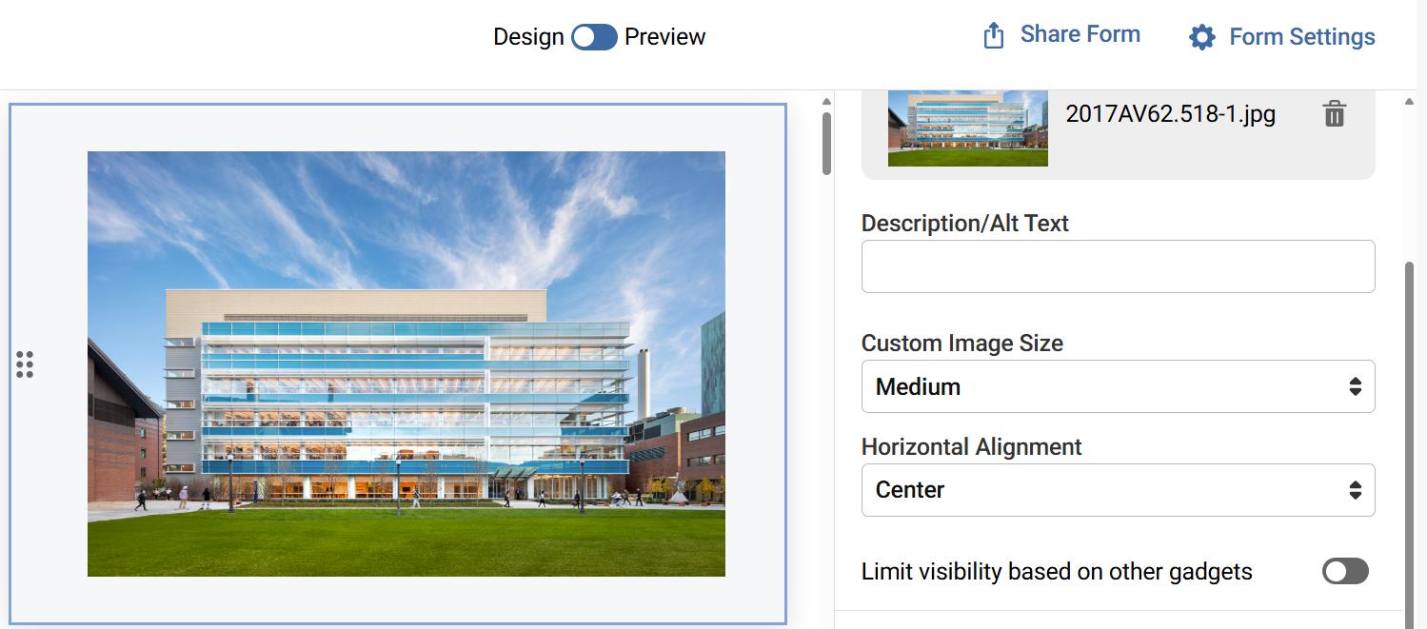
Read Only Images
They say a picture is worth a thousand words!
Customize your form
…Or use conditional logic to display instructional images,
a logo, QR Code, or process flow

Slide 13
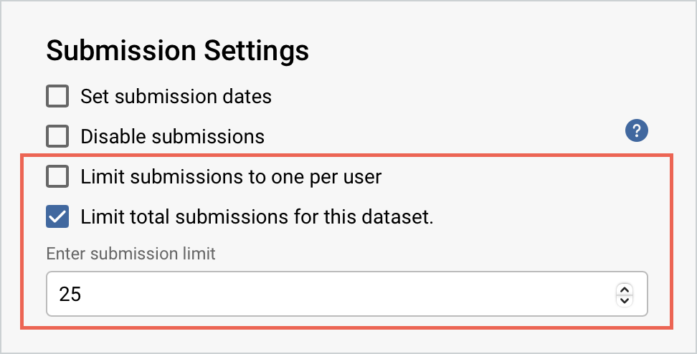
Limit # of Submissions
Configure Form Settings

Slide 14
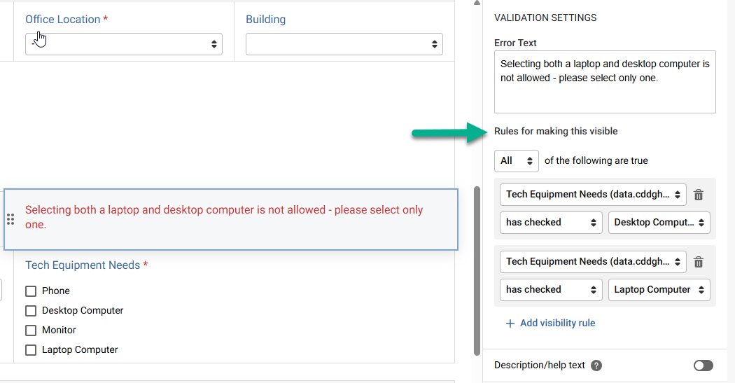
Validation Gadget Reduce user errors!
Prevent submission or workflow action
Display a custom error message based on field selections

Slide 15
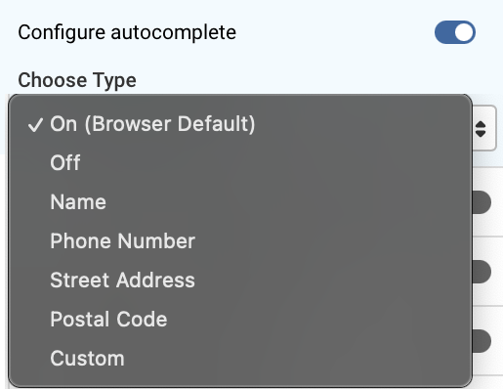
Autocomplete Options
For Short Text, Long Text and Email Gadgets
utilizes browser autocomplete settings to suggest a value on a form field for selection

Slide 16
Additional Data Lookup (Single Item) Input Options
If your data source requires an input, select the appropriate form or metadata field

Slide 17
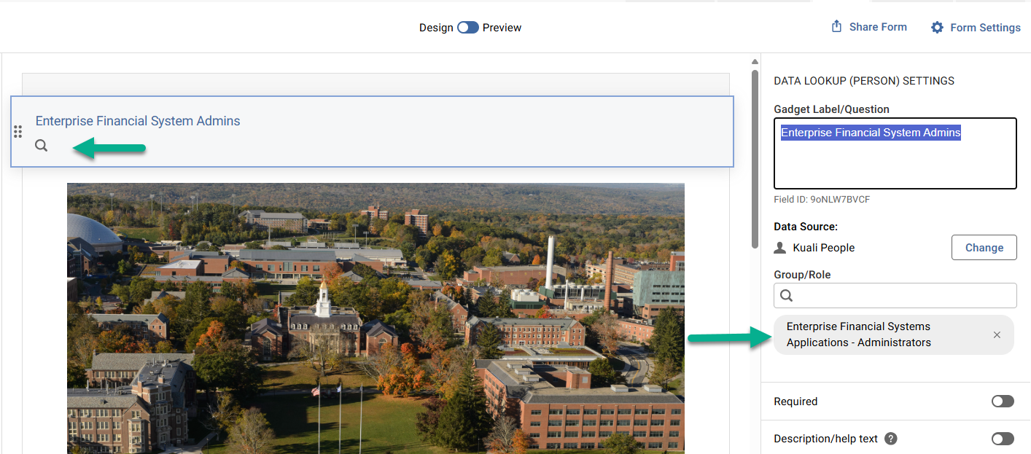
Data Lookup (List) and (Multiselect) Filtering
Filter Person Lookup by Group or Role
Narrow down your list of results

Slide 18
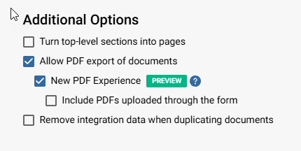
New PDF Experience
Generates a PDF that looks like the real form
Fully Accessible
Configure this option in Form Settings

Slide 19
New PDF Experience old & new side by side

Slide 20
What's New in WORKFLOW?

Slide 21
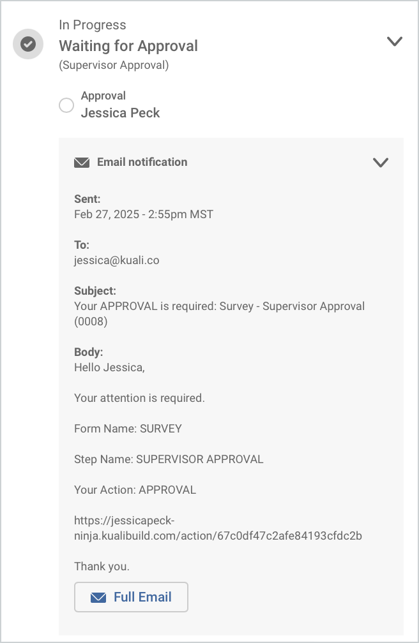
Workflow Notifications History Workflow Settings Option
History of all notifications sent for a given document
Viewable if the document is opened from the Document List or Action List (not visible to end user if document is opened from My Documents)
Workflow Status

Slide 22
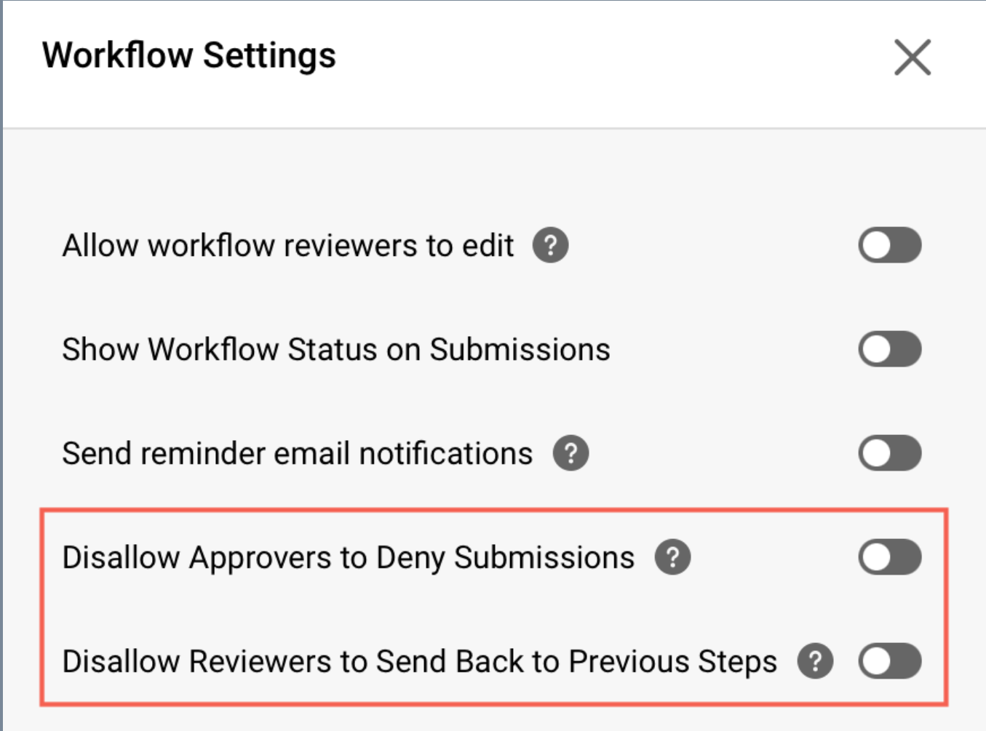
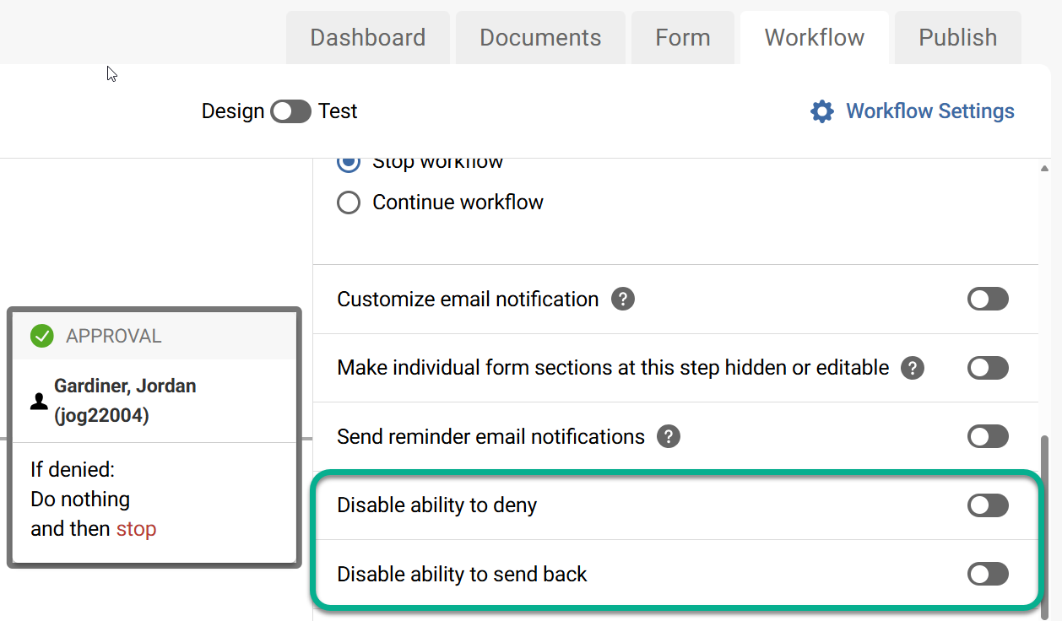
To Deny or Send Back? Configurable options
You may override overall workflow settings with an individual step configuration

Slide 23
What's Next? Looking ahead for Kuali Build
Internationalization
AI Integrations
Integrations in Anonymous Forms
Performance
Routing to External Users
Scheduled Notifications
Section Level Permissions
CSV Import

Slide 24
Kuali Circles Community Space
Connect with Peers
Learn from the Community
Engage with Kuali
Login required

Slide 25
Visit the Kuali Build Knowledge Base
Learn how to build an app, administer groups and manage submissions (Document List)

Slide 26
Contact Us!
Contact ITS Kuali Build Support
Visit the Technology Support Center Portal ​
Email techsupport@uconn.edu​
Call 860-486-4357
Help us help you! Include the name of your app!

Slide 27
Questions?

