Slide 1
Contact Center Express & Finesse
Tech Day
June 3, 2025
Jared Dewey & Rebecca Bentley
Notes:
Good morning and welcome to Contact Center Express & Finesse

Slide 2
Introduction
Rebecca Bentley
Assistant Director One Stop Student Services
Jared Dewey
ITS Contact Center Service Manager

Slide 3
Intro
What is UCCx
Benefits
Users
Cost
Finesse
Notes:
We will cover what is Cisco Unified Contact Center Express
We’ll go over some of the benefits that it can provide to your business and operations
What departments use it, some general cost information and Finesse which is the end users interface.

Slide 4
UCCx Basics
Agent/Supervisor
Customer calls in
Unified Contact Center Express
Finesse
Jabber/Phone

Slide 5
What is UCCx
Inbound/outbound voice solution
IVR & ACD
Realtime/Historical Data
Workplace Flexibility
Scalability/Redundancy
Notes:
WFH
Data collected
Call b

Slide 6
IVR & ACD
Interactive Voice Response
Automated Call Distribution
Call Back
Outbound Campaign
Information Messages
Notes:
UCCx is a complete call center application for call centers that have no agents and only automation up to 400 seats that gets a lot of calls.
Skillset
The goal best possible customer journey by leveraging the advanced integration features that are available.
Limited by our vision and creativity, or what one can think of.
Database lookup. Call back option when users are on hold, estimated time to wait, how many callers are ahead, informational hold messages,
Outbound call campaigns
Message of the Day for callers to listen to
Multiple lines directed to one number
Outbound calling campaign opportunity
User setting to allow calls to go to distribute to the front line staff first and if all on calls the call will be directed to next level.
Call Back feature – calls in queue waiting take priority over those that want a call back.
Message of the day option – inclement weather, high volume, deadlines, any information that may be answered in the message. Control of creating and removing.

Slide 7
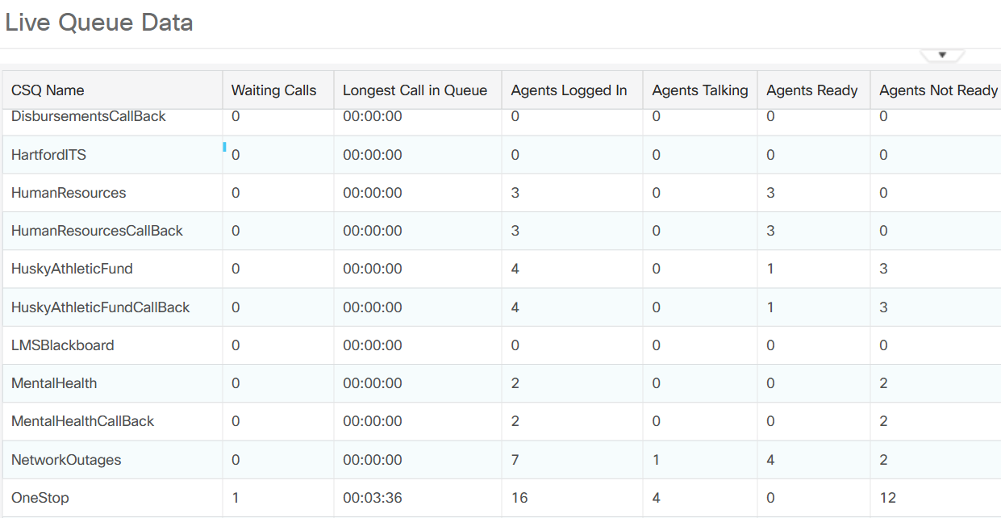
Real time reporting
Notes:
As part of the user interface we have real time reporting, supervisors can see how many calls there are, agents logged in, how many on calls, how many ready or not and so on.

Slide 8
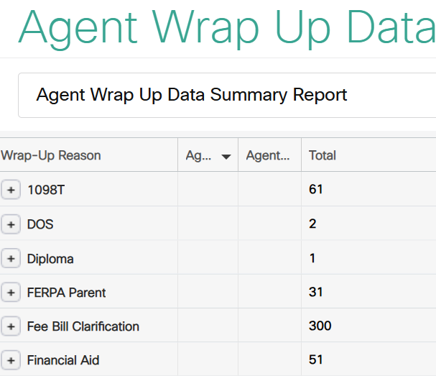
Historical Reporting
Notes:
Agent Wrap Up Data, when the call completes, the agent gets an opportunity to classify the call
Traffic Analysis Report single day, peak call times were 2-3pm and 3-4pm.
Can also see how many calls came in on days off (Saturday, Sunday opening weekend – last year did not have phones on, this year we will based on the volume we saw)

Slide 9
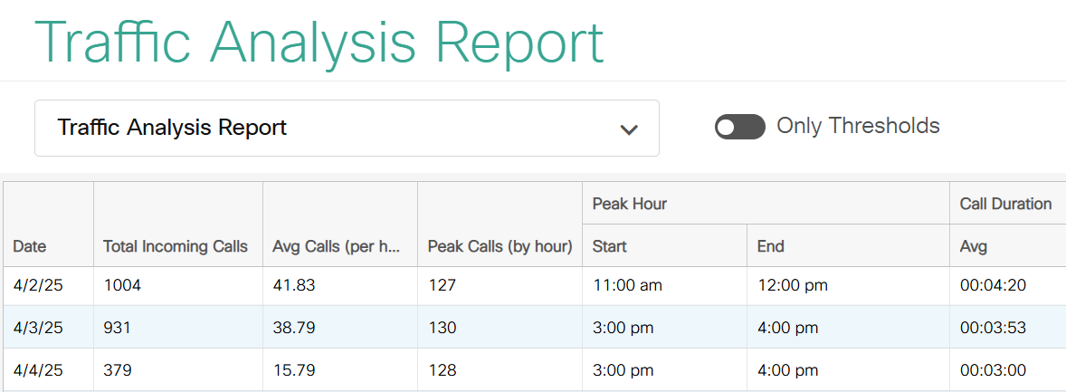
Historical Reporting Continued

Slide 10
Flexibility Scalability Redundancy
PC/Headset/Internet
UCCx supports 0-400 agents
Easy to add/remove agents
Redundant servers
Notes:
Since covid we’ve seen an increase in telework. With a computer, headset and internet connectivity you can access UCCx from anywhere. We have a software phone called jabber, which is an application that runs on the computer and provides phone service. The agent interface is done in a web browser. This makes it very easy to work from anywhere.
UCCx supports 0-400 concurrent agents. Adding agents is done by the telecom group and we can easily add or remove agents and supervisors, adjust skills and skill levels.
WFH

Slide 11
Benefits
Customer Satisfaction
Workforce Management
Too few agents
Hold time increase, hang up, customer frustration
Service levels drop
Too many agents
Increased staffing costs
- Lower productivity
Notes:
Benefits, most importantly is customer satisfaction. We want to get the caller the information or answers they are looking for as quickly as possible.
You can use the reporting features optimize your workforce. If we have too few agents, hold or wait time increases as does the number of hang ups or abandoned calls.
Your customers get frustrated and the service level goes down. If we have too many agents, we have increased staffing costs and productivity is generally lowered.

Slide 12
Benefits continued
Quality management
Agent monitoring
Identify training needs and effectiveness
Successful interactions, happy customers
Departmental control
Schedule
Holiday
Emergency
“Barging In” to take over a call
Notes:
Quality management. Supervisors have the ability to listen in on an agents call. Combine this with reporting metrics and supervisors can identify training needs and agent effectiveness.
The quicker an agent can service that call, the customer can be happy and the agent becomes available to assist another caller.
We build in departmental control. Open and closed hours are set along with standard holidays.
We can give departments the ability for a customer closure, in the event of an emergency or they have a last minute closure for any reason, there is a number to call into where they can close the call center with a temporary message.
Music on hold messages can be changed or rotated for business needs.

Slide 13
Users
One Stop Student Services
IT Technology Support Center
Accounts Payable
Human Resources
Husky Athletic Fund
Student Health and Wellness
Parking Services
Ticket Sales
Coming soon Res Life
Notes:
We have quite the wide variety of departments that are using the product.
The next department to go live will be Res life. We did agent/supervisor training yesterday and will go live Thursday. Here are some other departments that utilize Contact Center Express.

Slide 14
Costs
Variable Cost
Fixed Cost
Supervisor
Scripting
Agents
Notes:
There are two types of costs, variable pricing which is a one time charge.
Agents and supervisors are a fixed cost and it is based upon the max concurrent number of agents and supervisors logged in.
Exact costs for agents and supervisors can be obtained through the ITS Business Office

Slide 15
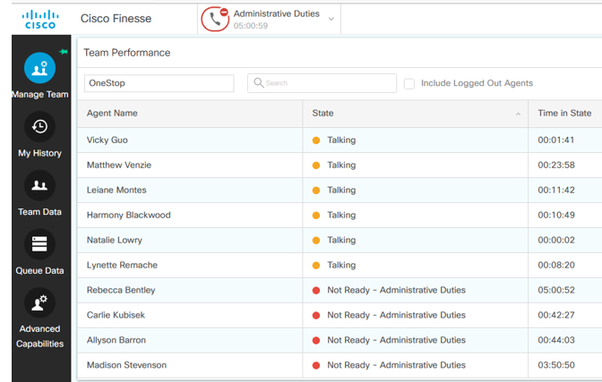
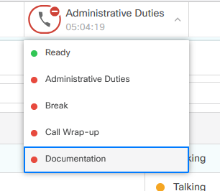
Finesse
Notes:
Dashboard: Who is talking, time in that state, who is signed in
Different status can be used for reporting, we don’t use it for that, we use it for status of staff in office. explain

Slide 16
Finesse
Notes:
This report is used for knowing the time calls came in and number they called. We use for volume during off hours. Example: last opening weekend we did not have phones on. We used this report to determine that this upcoming opening weekend we will have phones on!
We also use the Called Number because we have 4 phone numbers coming into one.

Slide 17
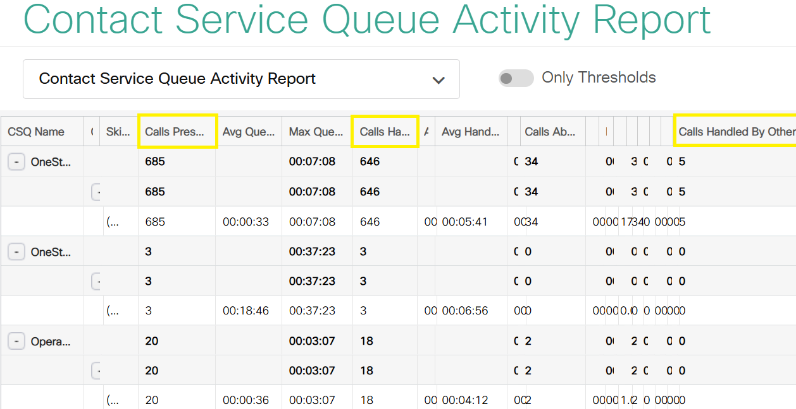
Finesse

Slide 18
How to get started
Stay here with us in Rm 109 or Rm 110
Submit a request through Jira techsupport@uconn.edu
Jared Dewey
Jared.dewey@uconn.edu
Rebecca Bentley
rebecca.bentley@uconn.edu
Questions?

Slide 19
Copyright
Copyright © University of Connecticut Information Technology Services 2018. This work is the intellectual property of the author. Permission is granted for this material to be shared for non-commercial, educational purposes provided that this copyright statement appears on the reproduced materials and notice is given that the copying is by permission of the author. To disseminate otherwise or to republish requires written permission from the author.

