Slide 1
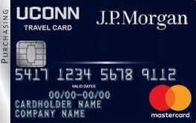
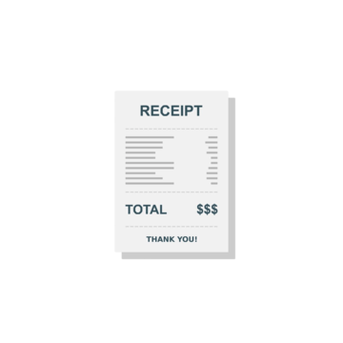
Concur Expense Made Easy!

Slide 2
Meet the Team
Nancy Patrylak- Manager of Travel and
Card Services
Alyssa Wojcik- Travel Services Specialist
Katherine Papalionakis- Travel Services
Bryon Moore- Business Systems Analyst

Slide 3
General Information
Travel from Start to Finish
Travel Card Request Form/Increases
Future Dated Trips and Timeline for Submission
Charges and Refunds on Expense Reports
Bi-Weekly Open Labs

Slide 4
Steps for Success
Go to your approved Request and click the Create Expense Report button
Complete Report Header and add expenses
Create your Travel Allowance Itinerary and Per Diem selections
Add receipts/supporting documents, expense types, and itemize hotel lodging expenses if applicable
Make any allocations (this includes any Travel Awards you receive) if needed
Submit Report

Slide 5
DEMO

Slide 6
Questions?
Reach out at travel@uconn.edu
trave
Travel.uconn.edu for
training and resources

